Slide 1


Slide 2
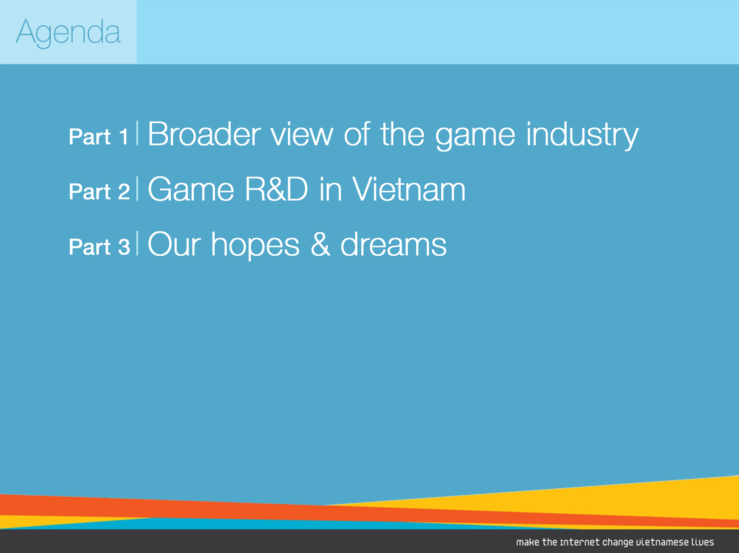

Slide 3


Slide 4
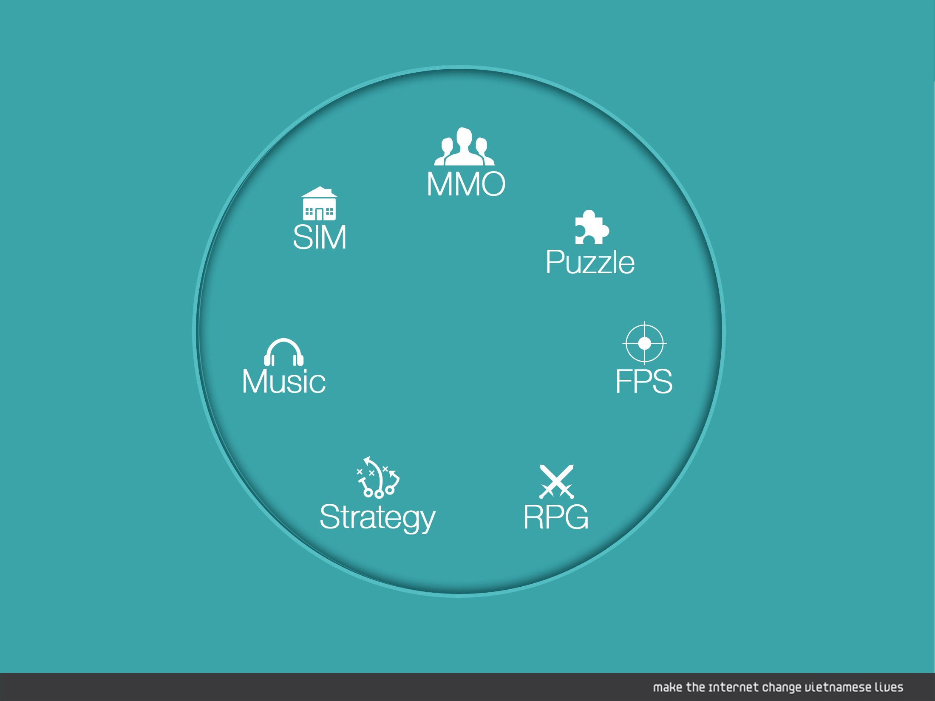

Slide 5
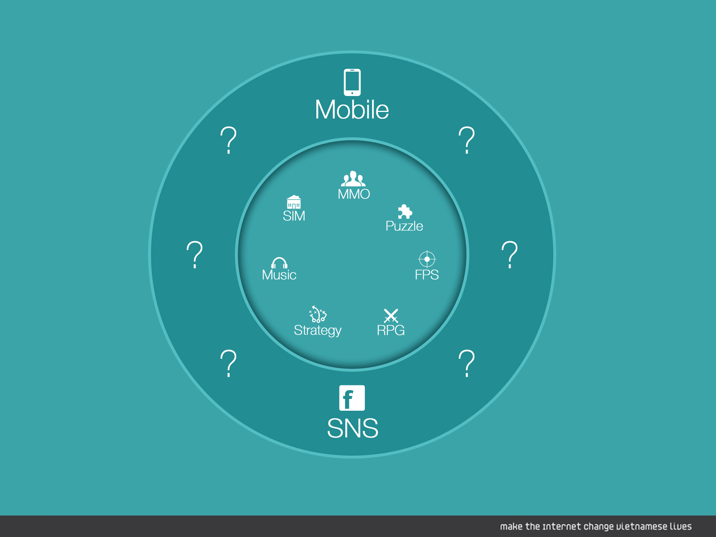

Slide 6
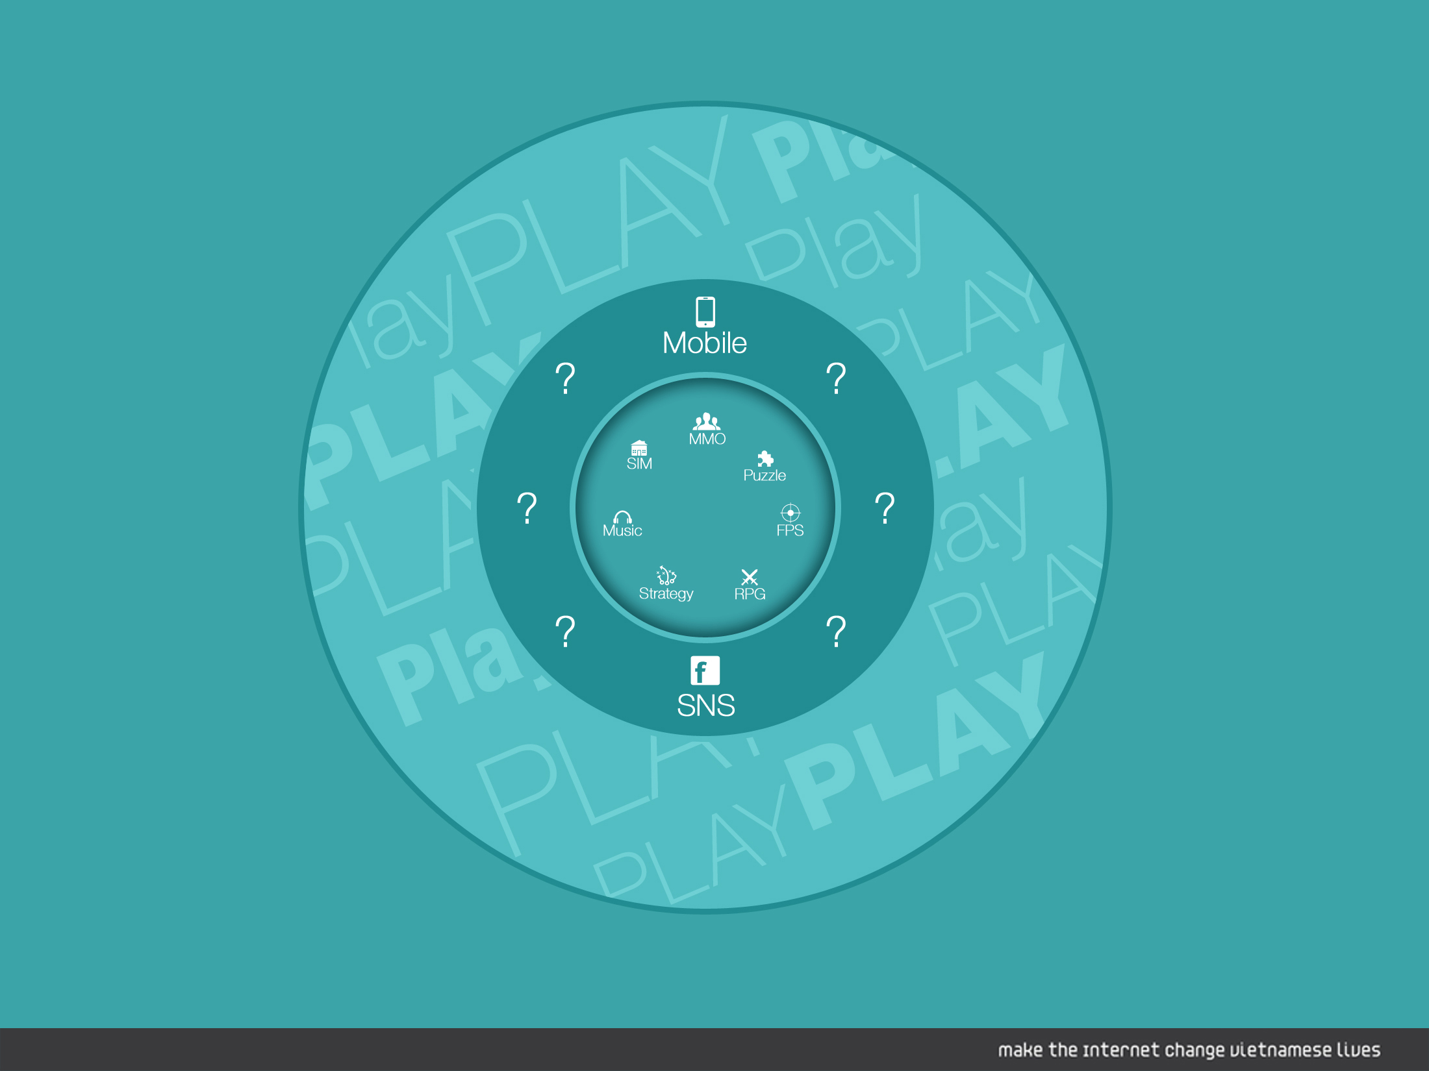

Slide 7
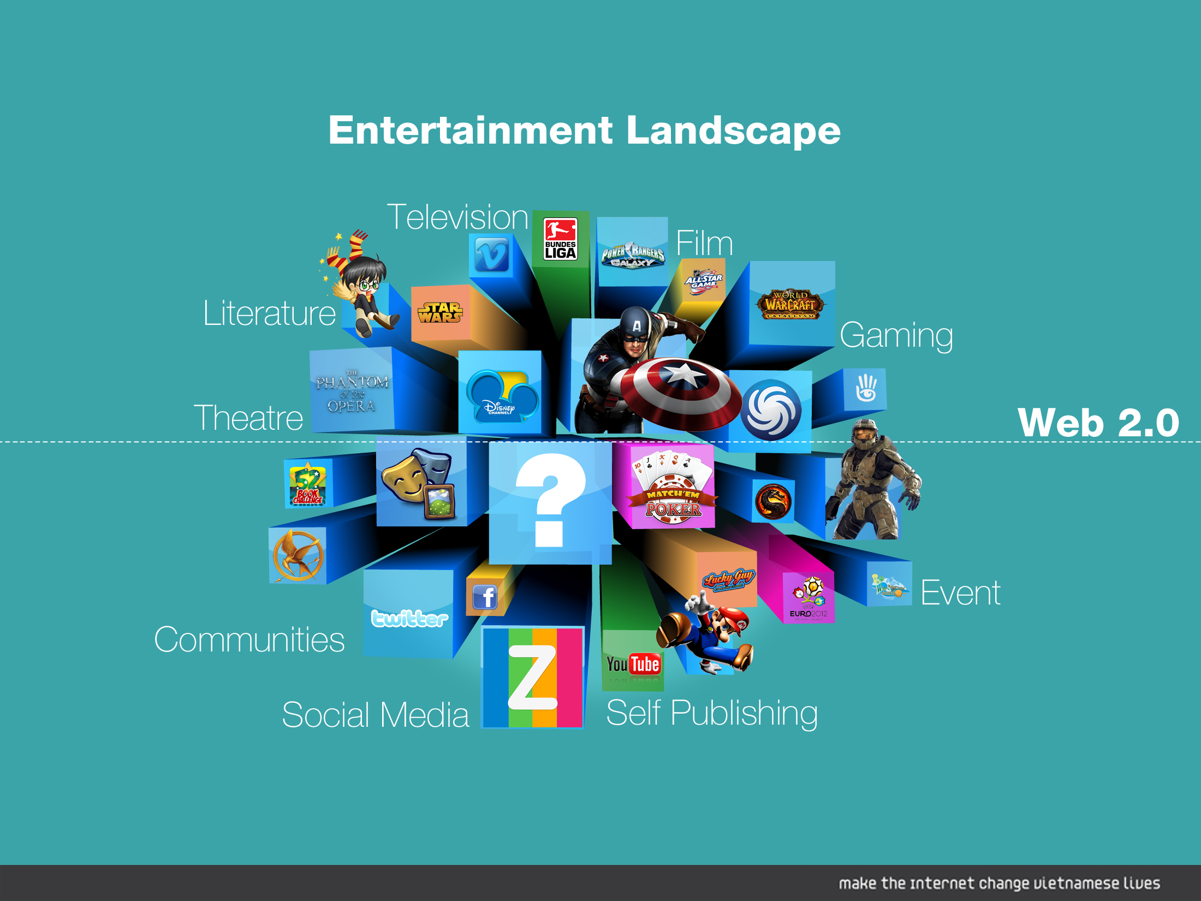

Slide 8
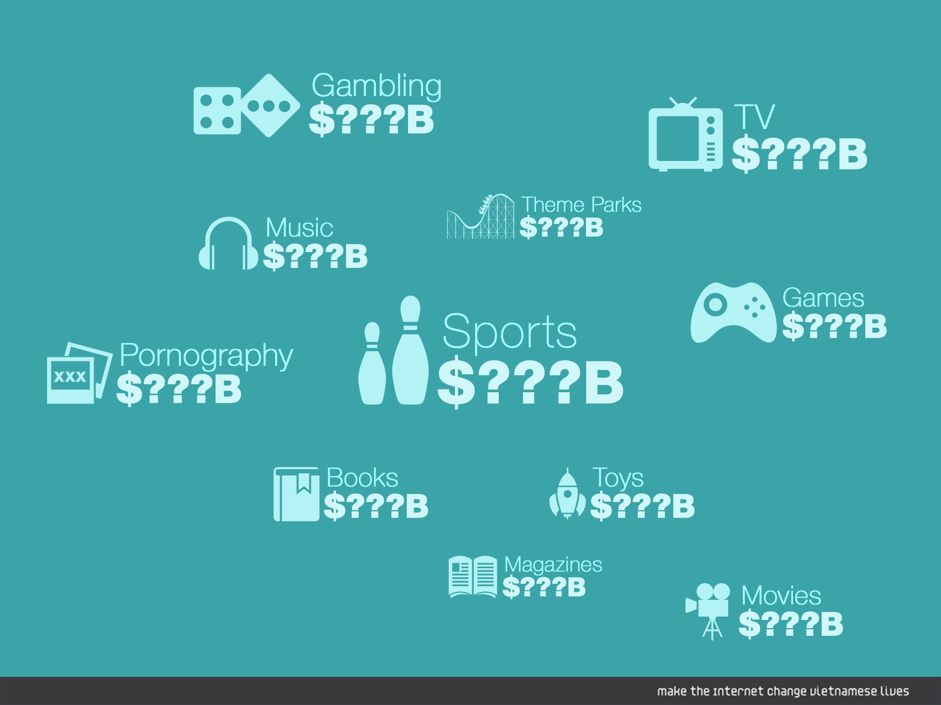

Slide 9
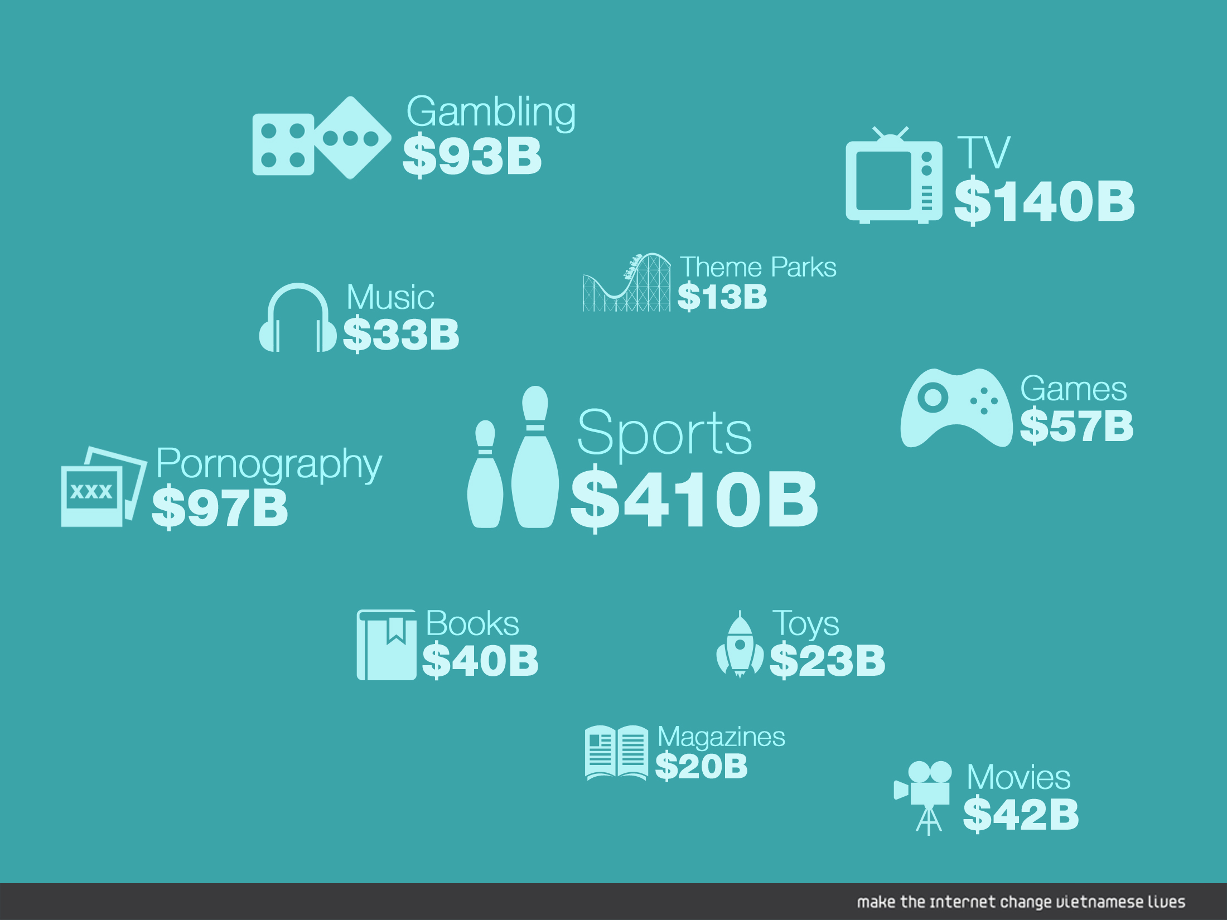

Slide 10
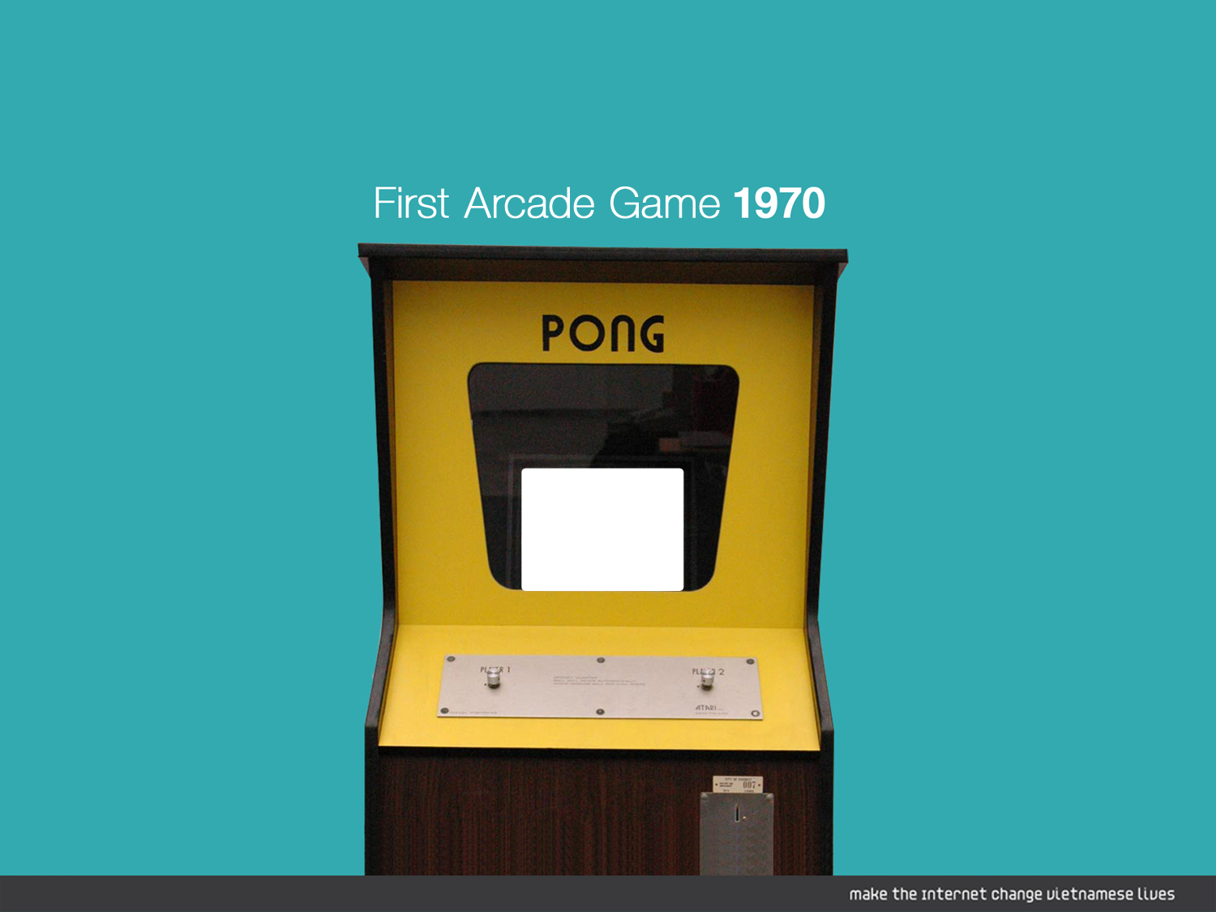


Slide 11
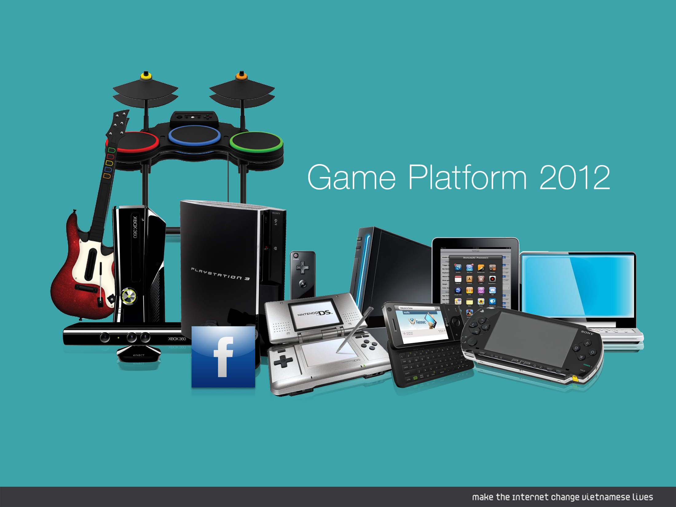

Slide 12
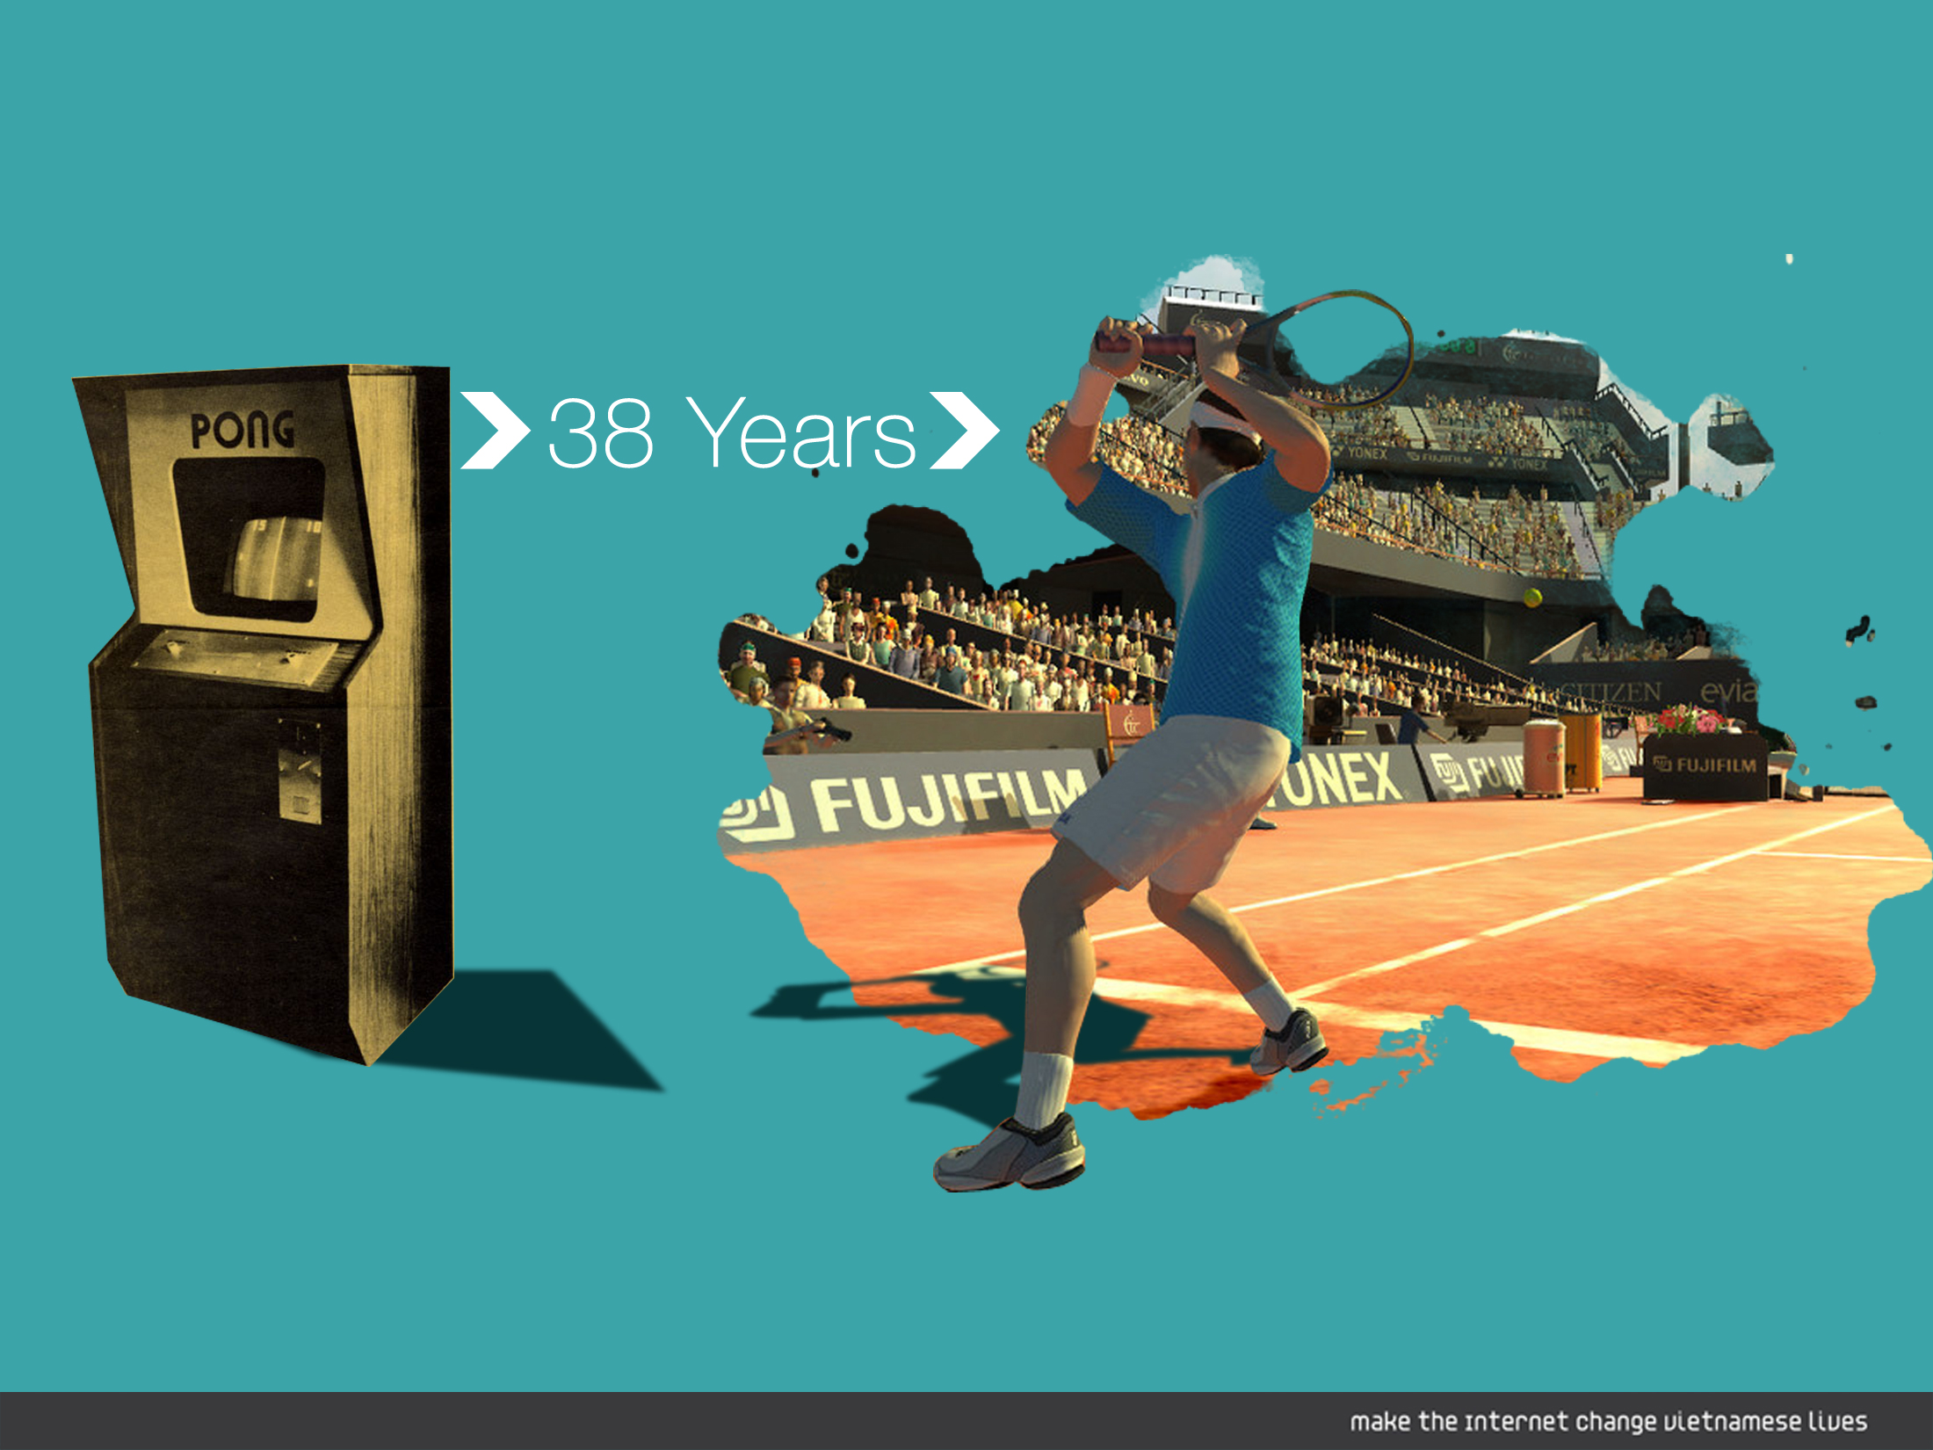

Slide 13


Slide 14


Slide 15
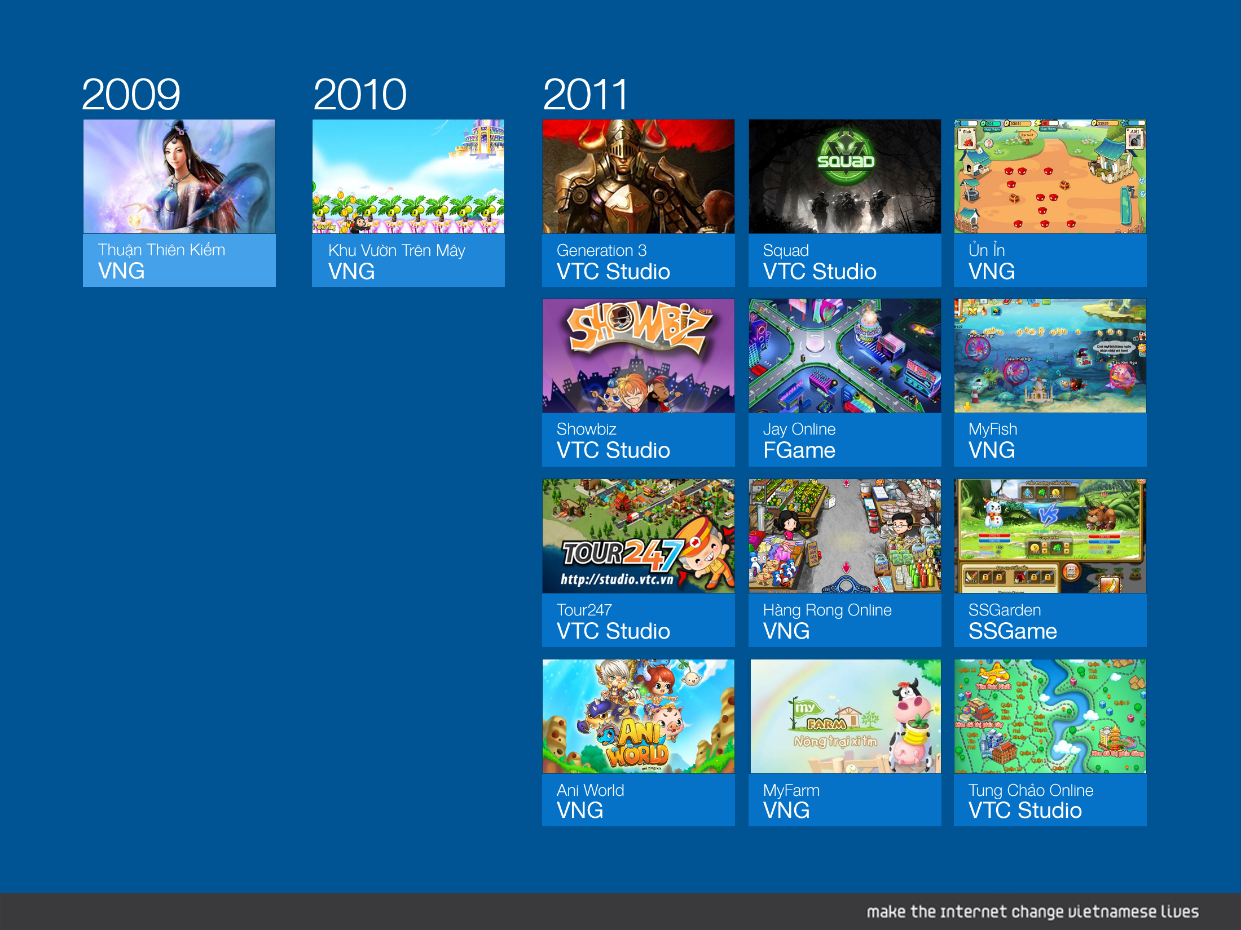

Slide 16
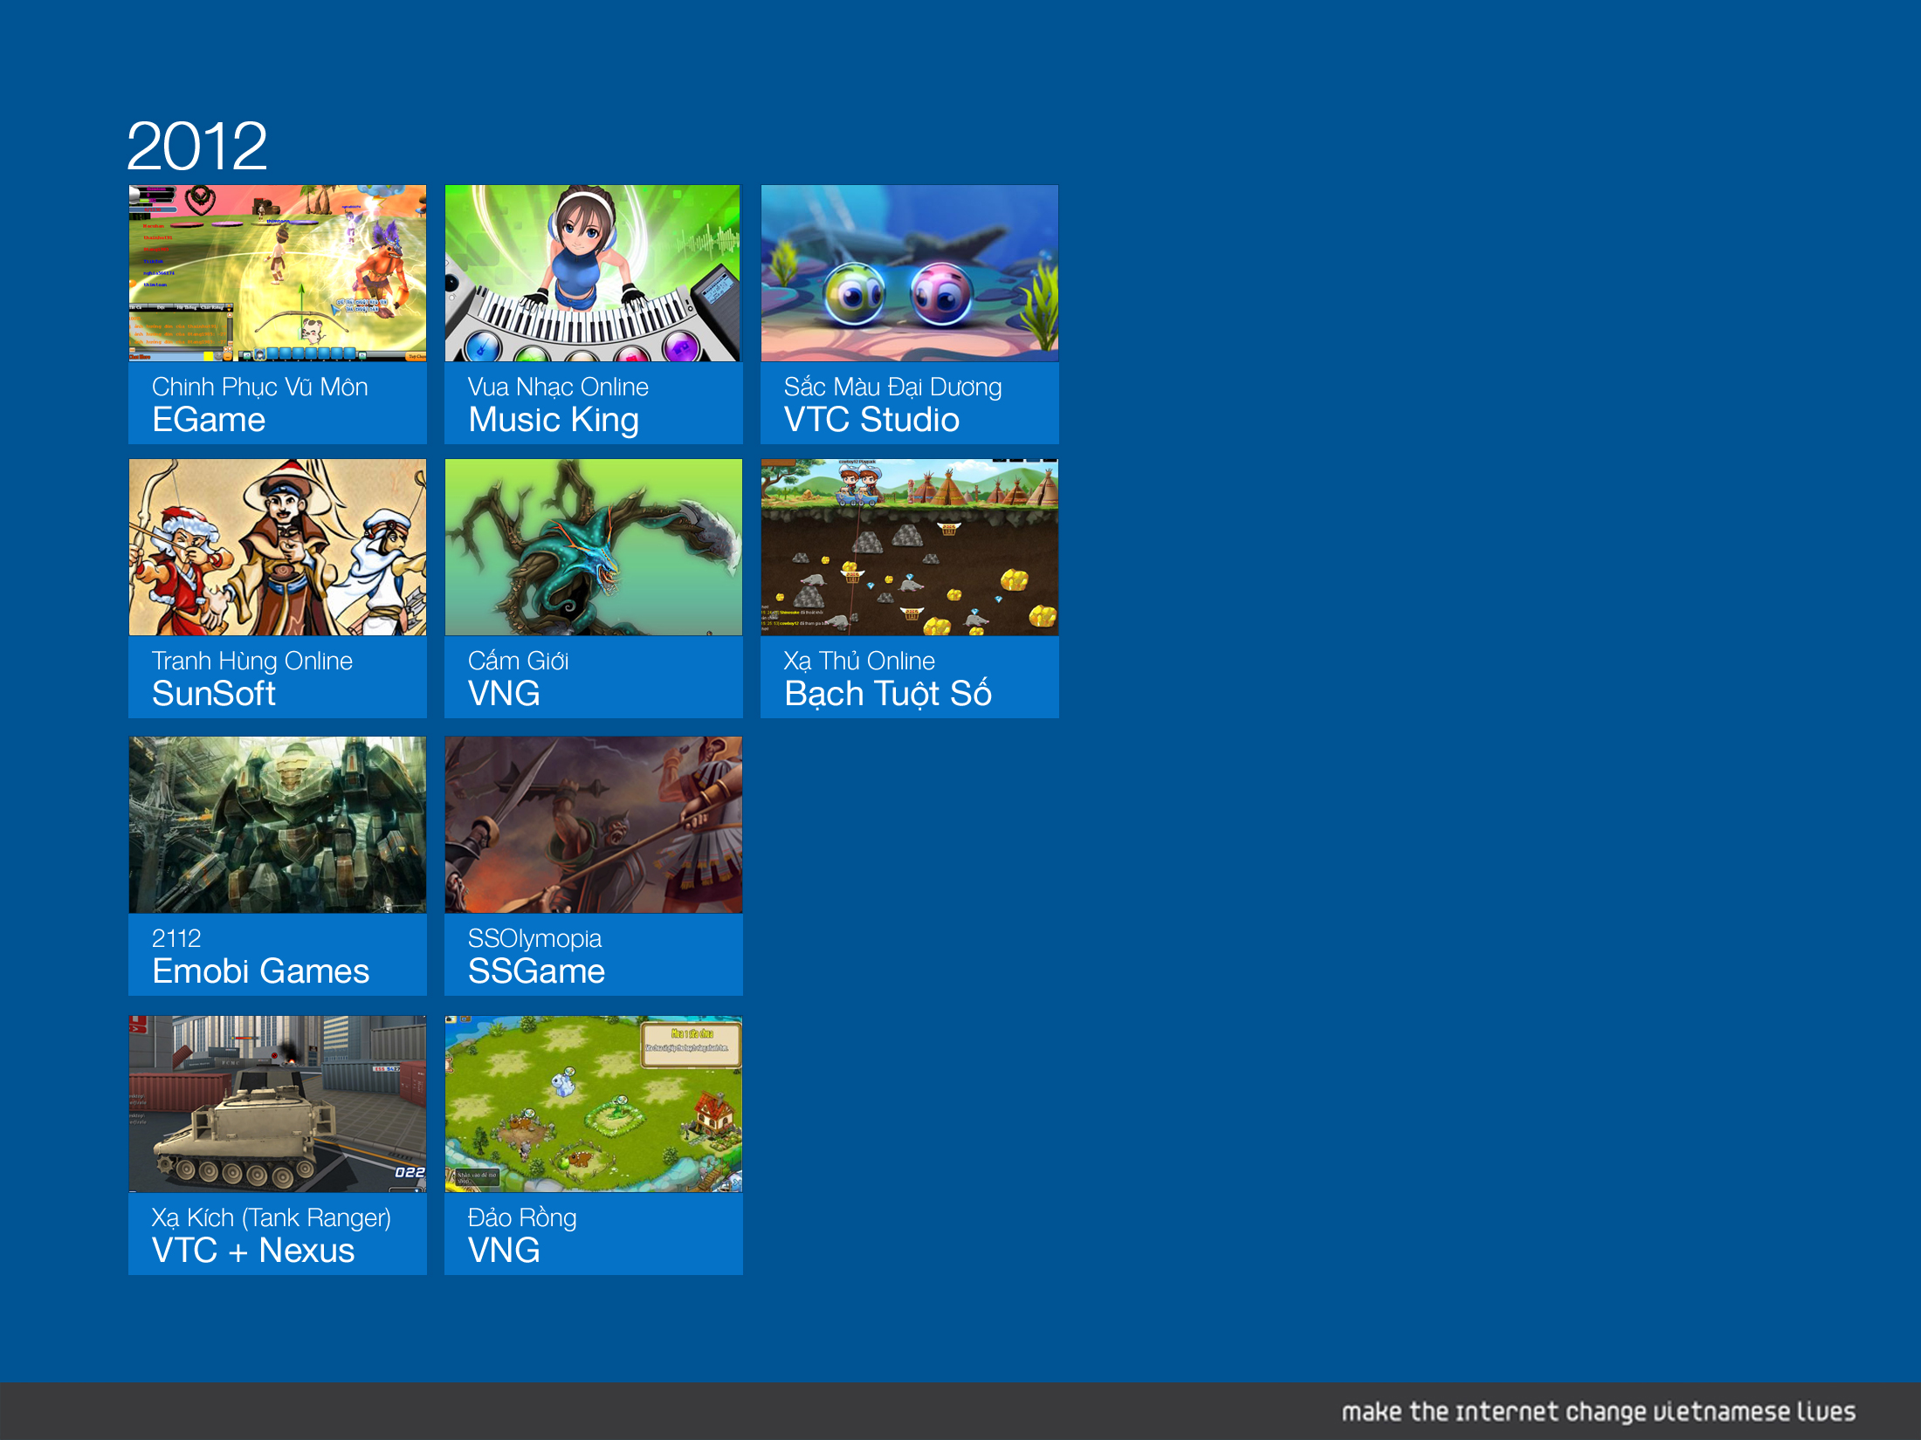

Slide 17
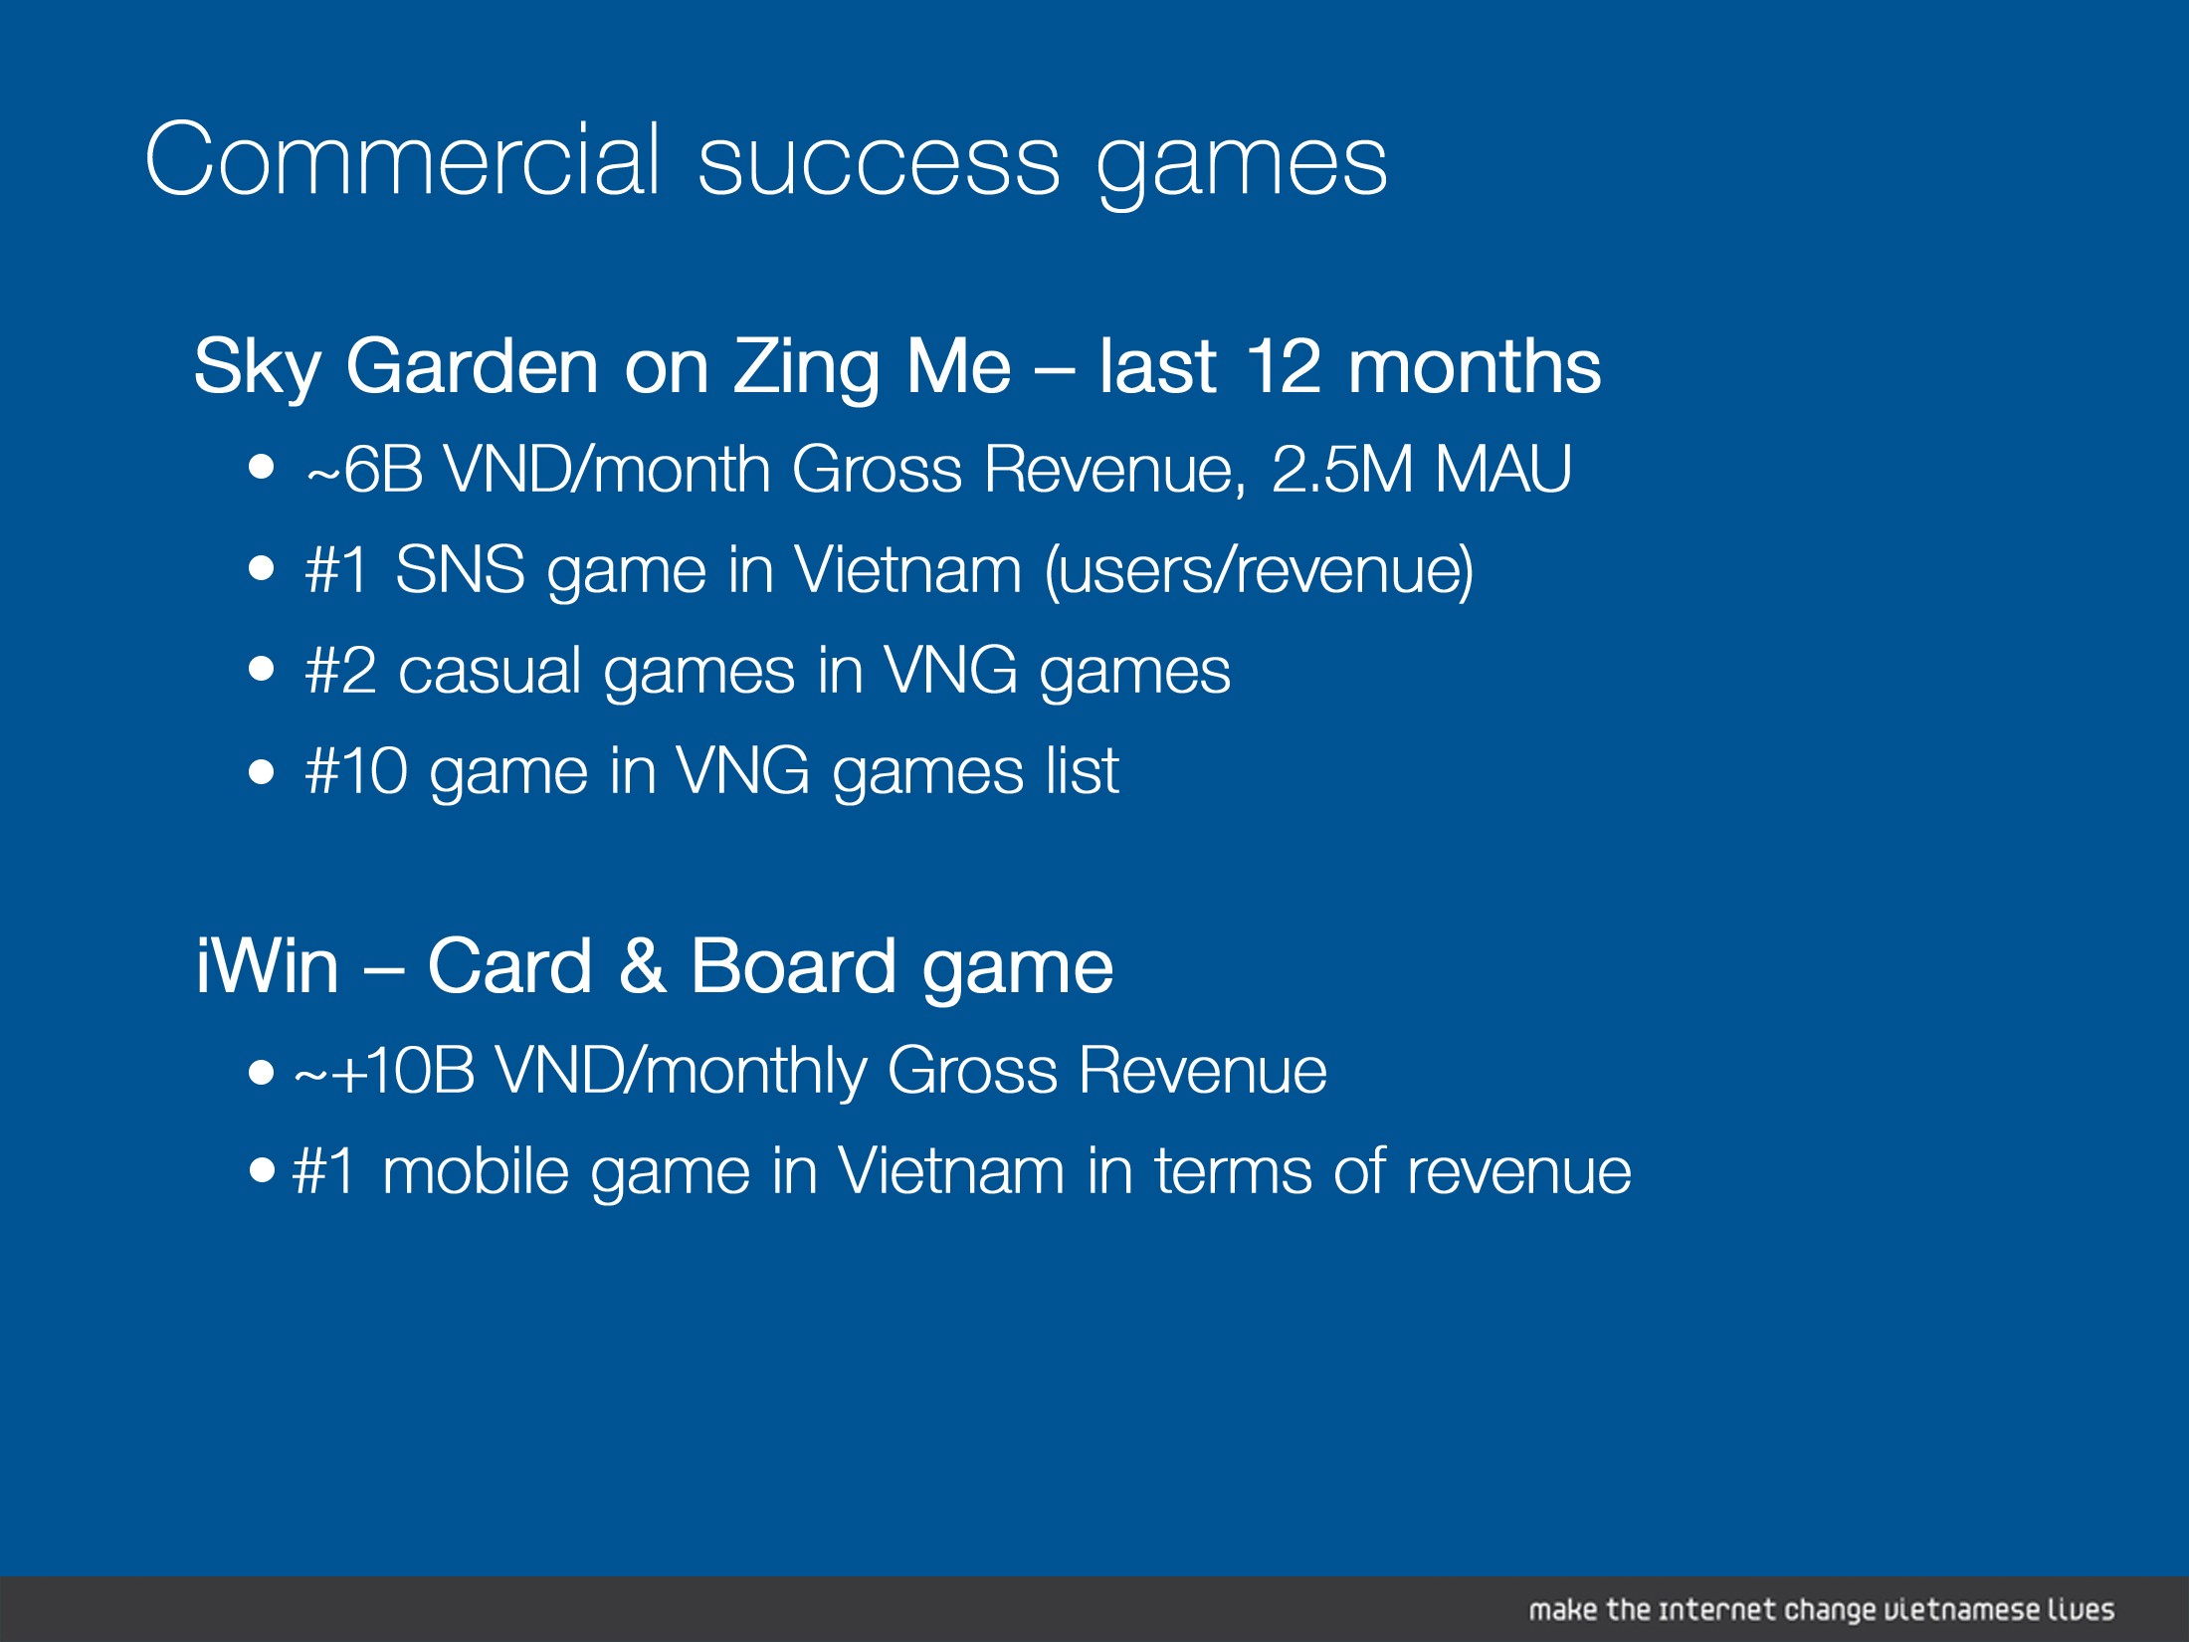

Slide 18
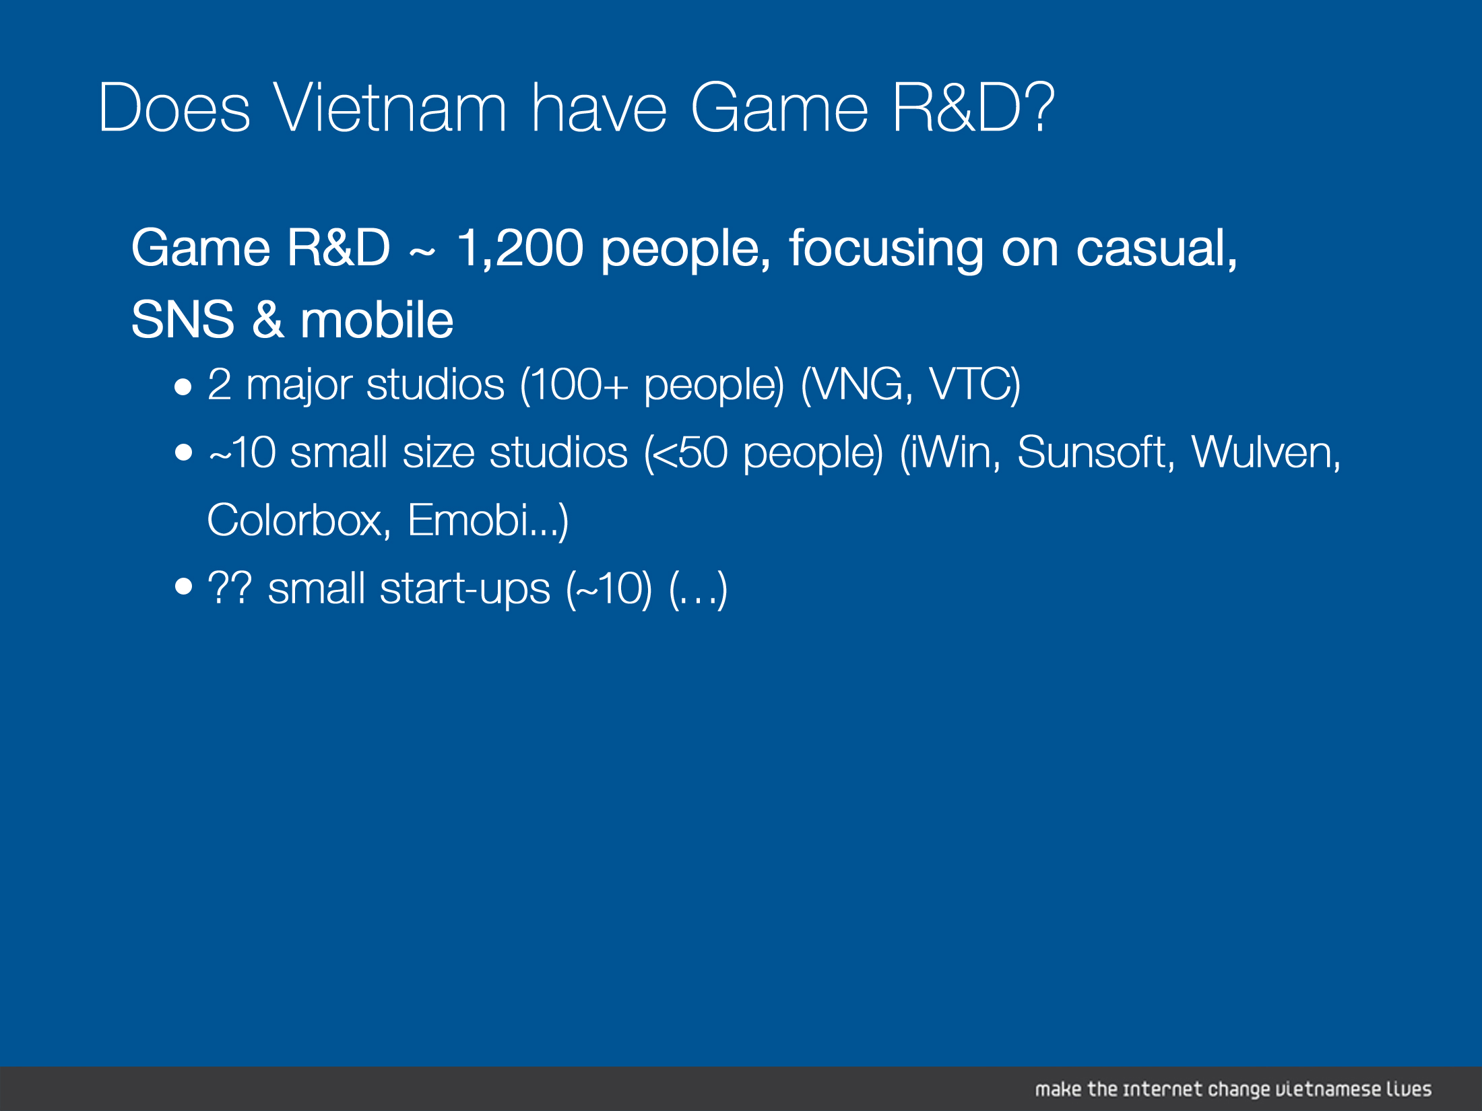

Slide 19
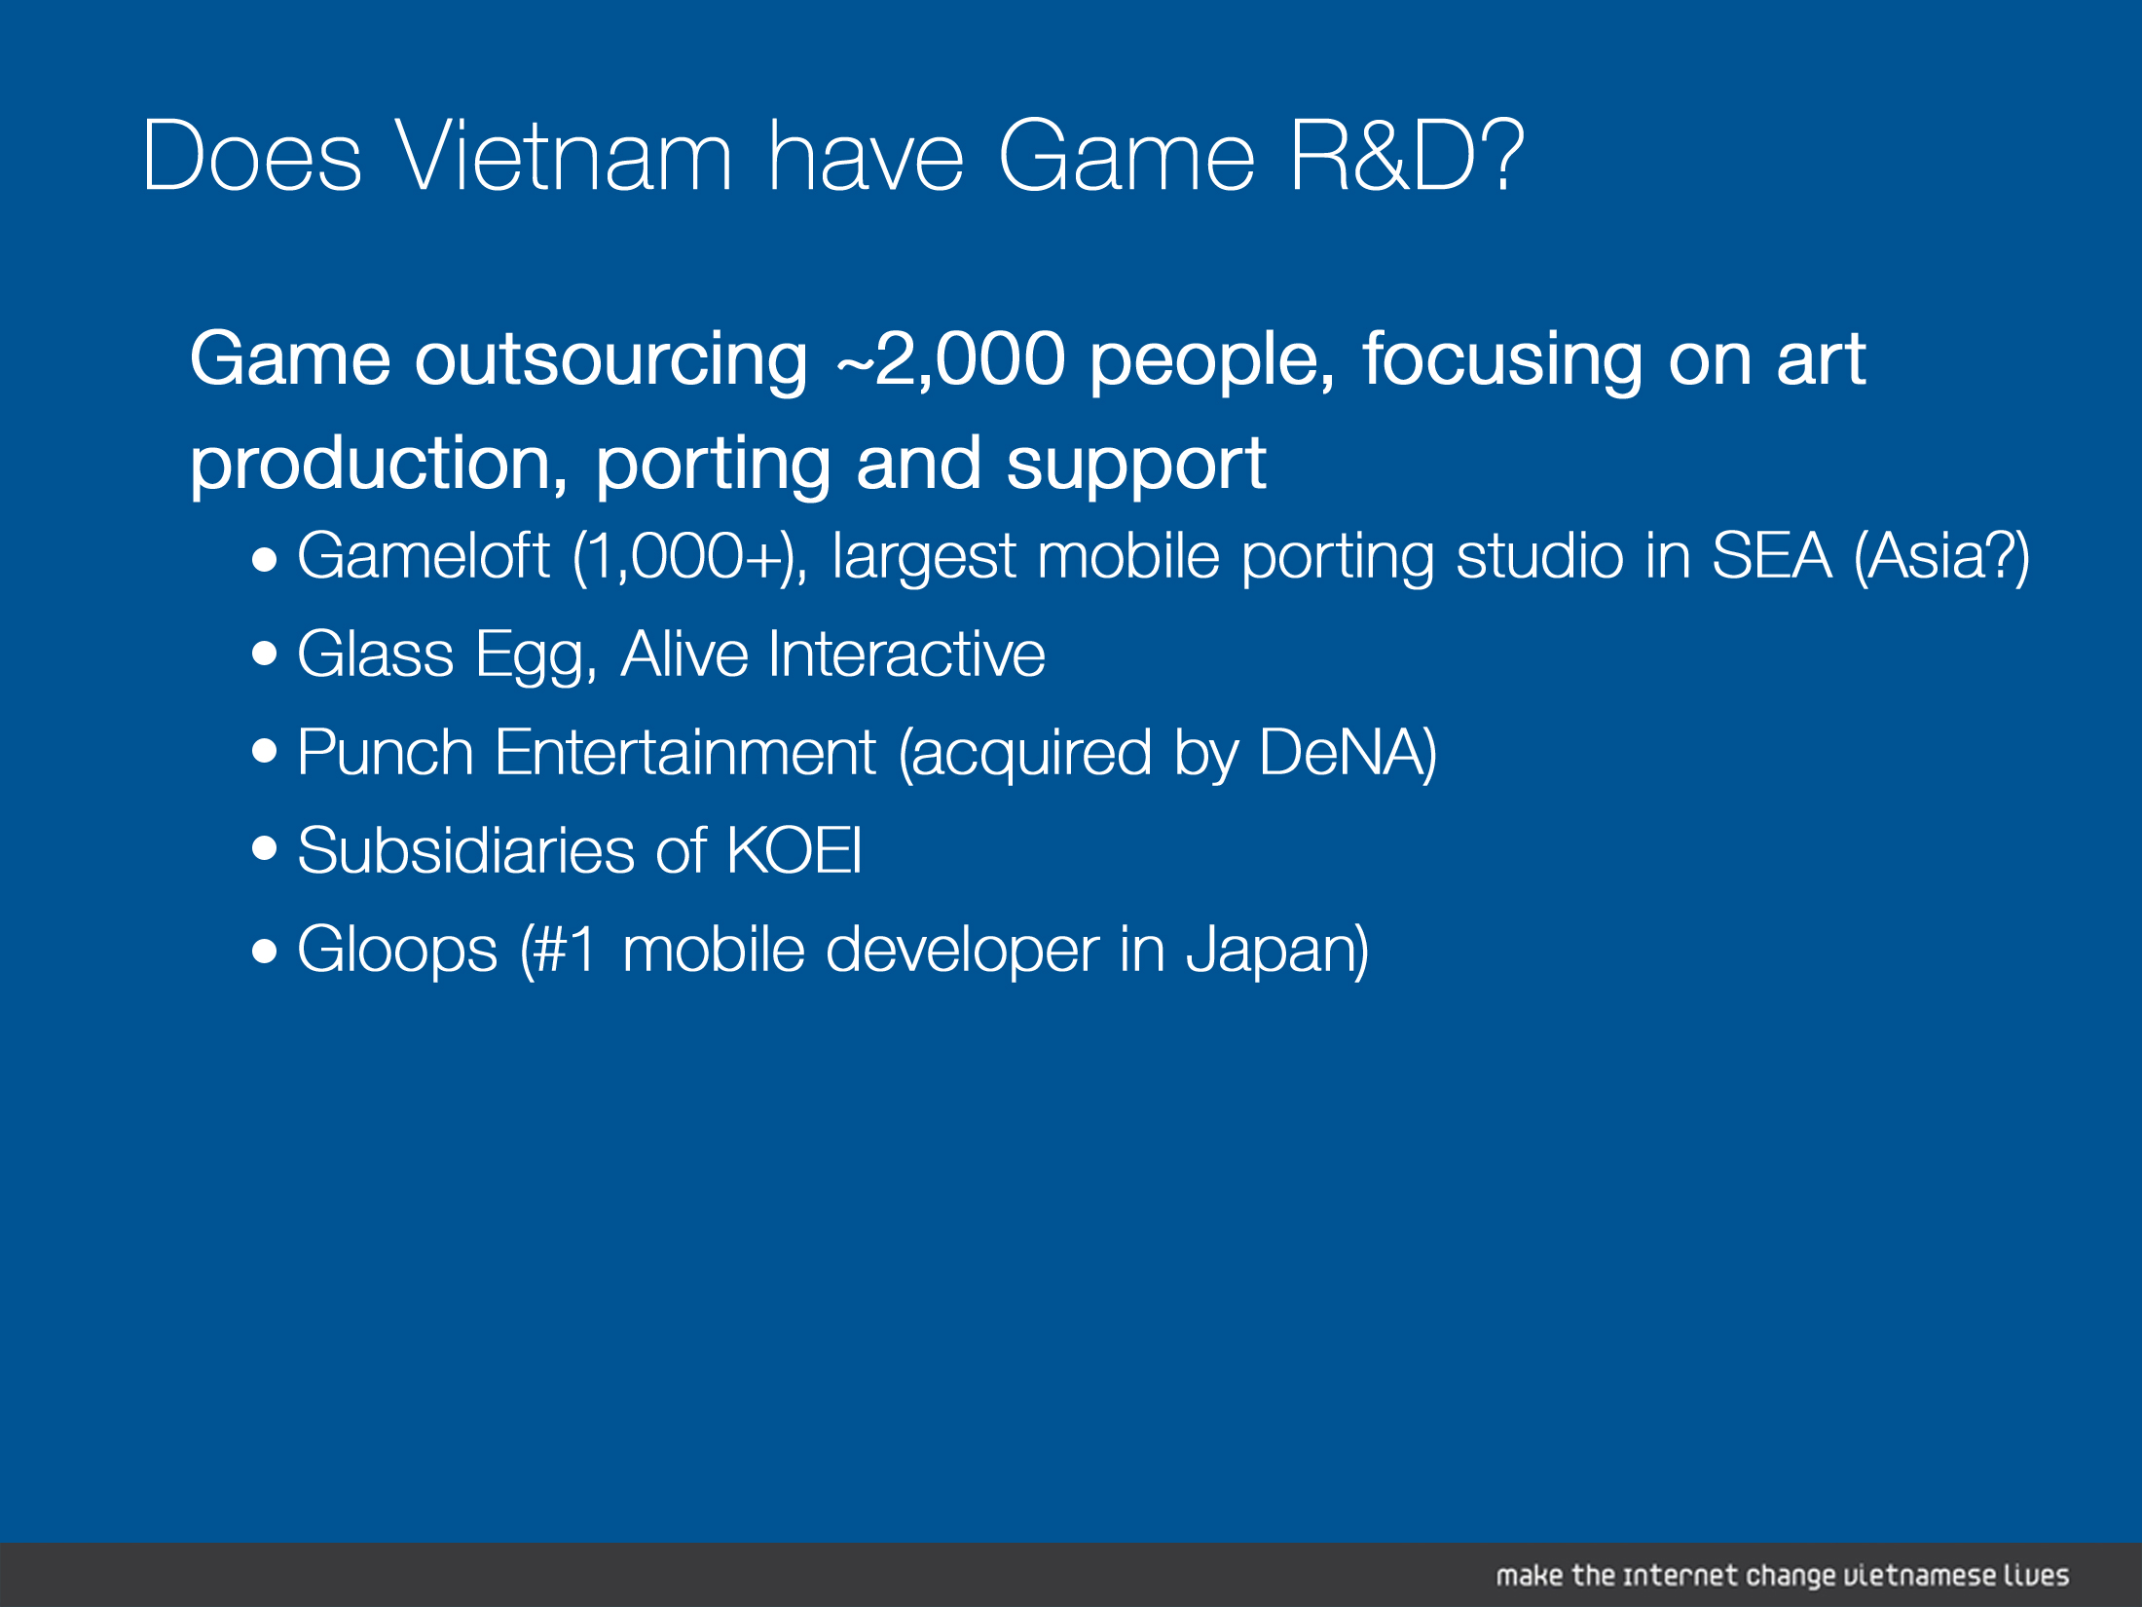

Slide 20
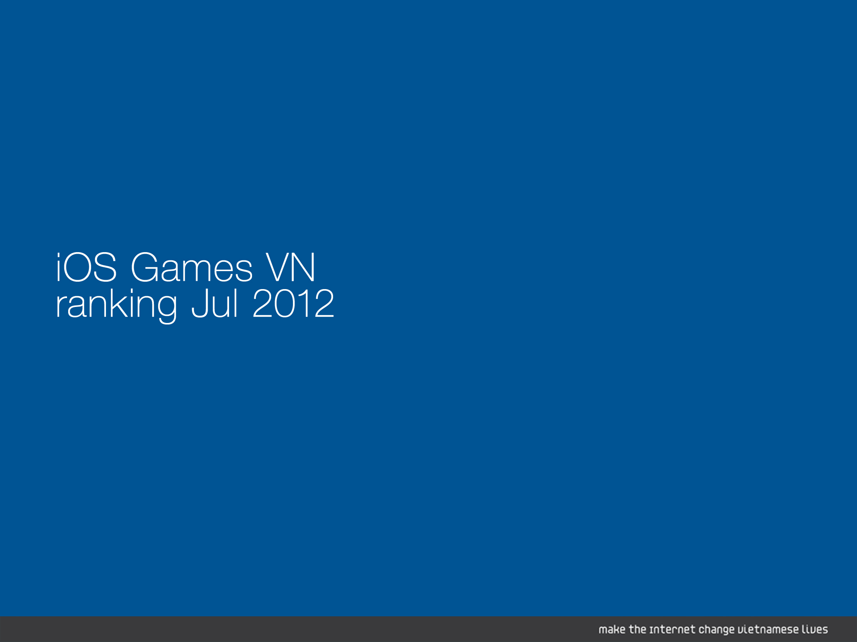
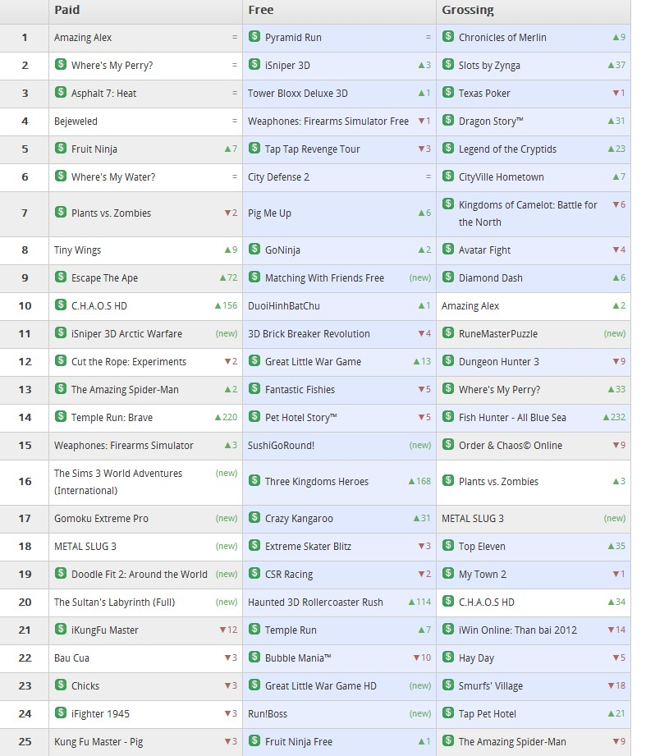




Slide 21
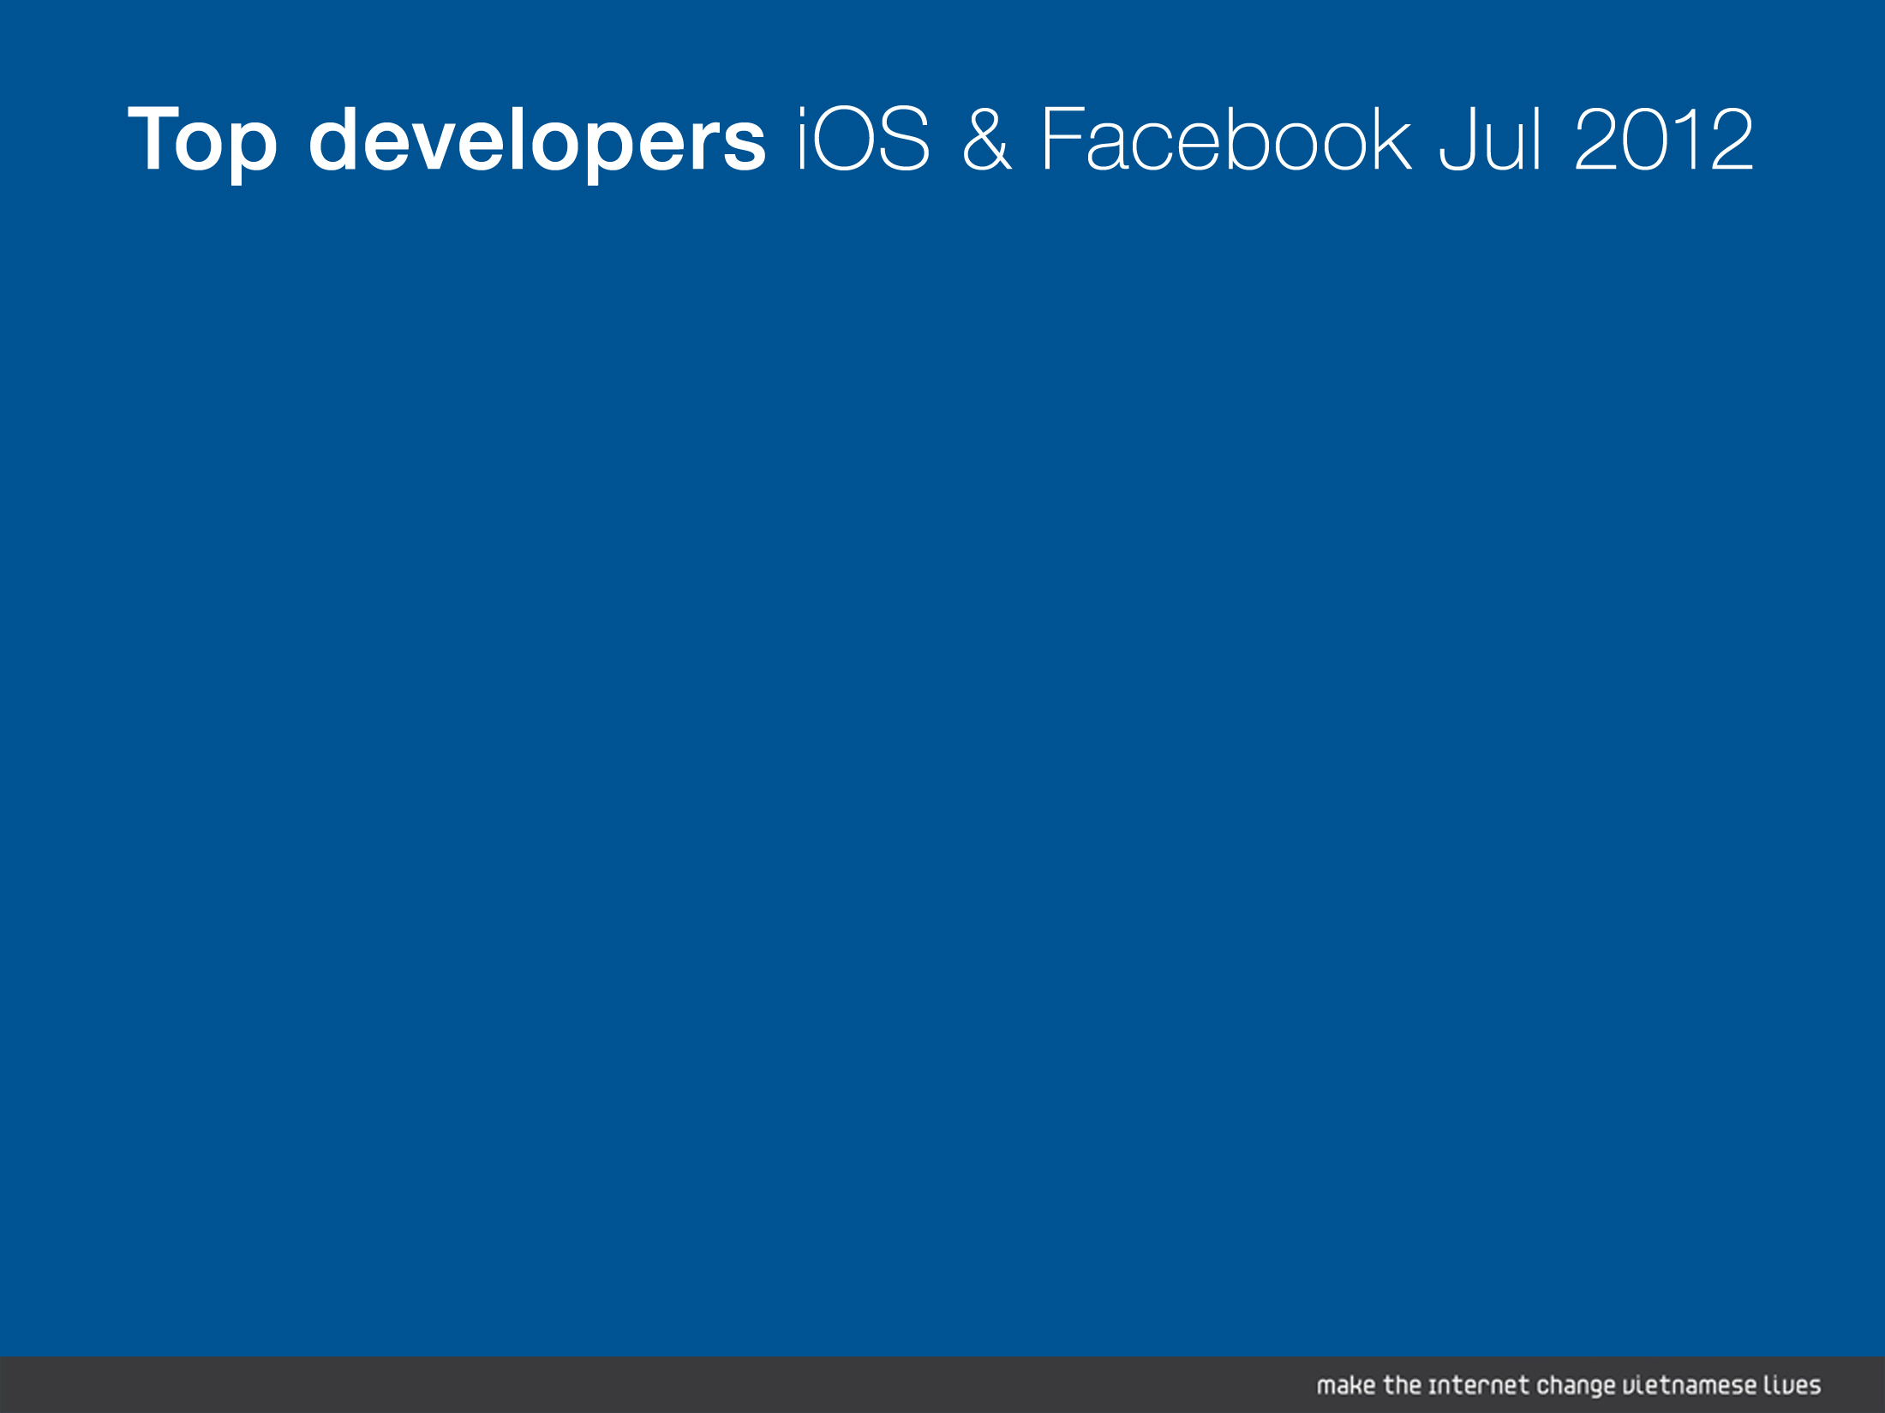
Countries | Games
Australia | 1
Austria | 3
Canada | 2
China | 2
Cyprus | 1
Czech | 1
Finland | 3
France | 1
Germany | 1
Hong Kong | 1
India | 1
Japan | 4
N/A | 15
Russia | 1
South Korea | 1
Sweden | 3
Switzerland | 1
UK | 7
US | 51
Countries | Companies
Australia | 1
Canada | 1
China | 3
Czech | 1
Finland | 3
France | 3
Germany | 4
Hong Kong | 2
Israel | 1
Korea | 1
N/A | 21
Netherlands | 2
Spain | 2
Sweden | 2
Switzerland | 1
Taiwan | 1
Turkey | 3
UK | 2
US | 46

Slide 22
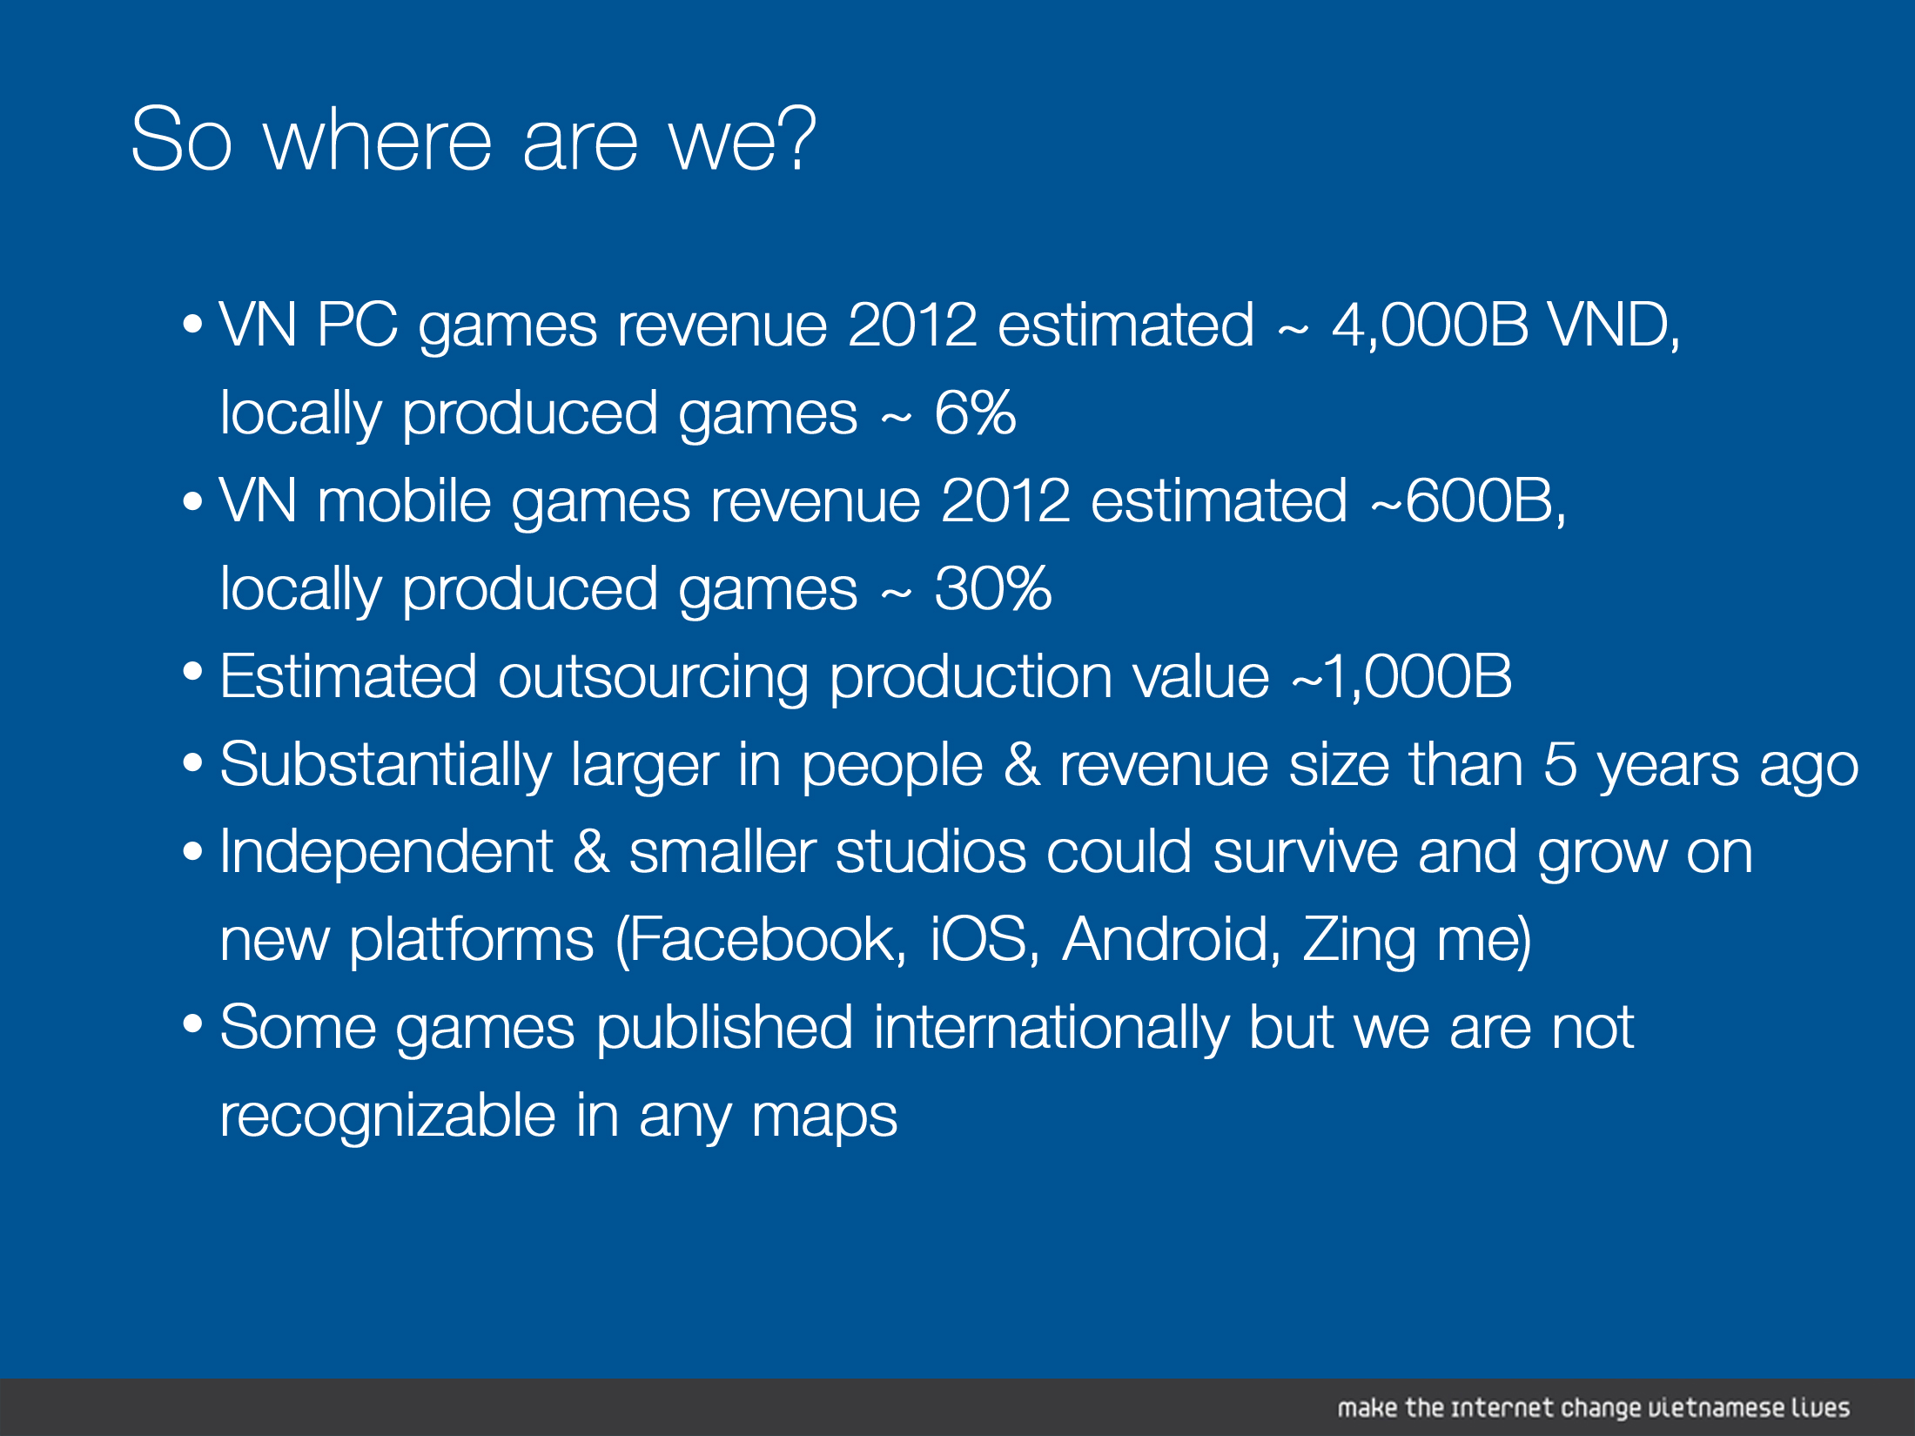

Slide 23


Slide 24
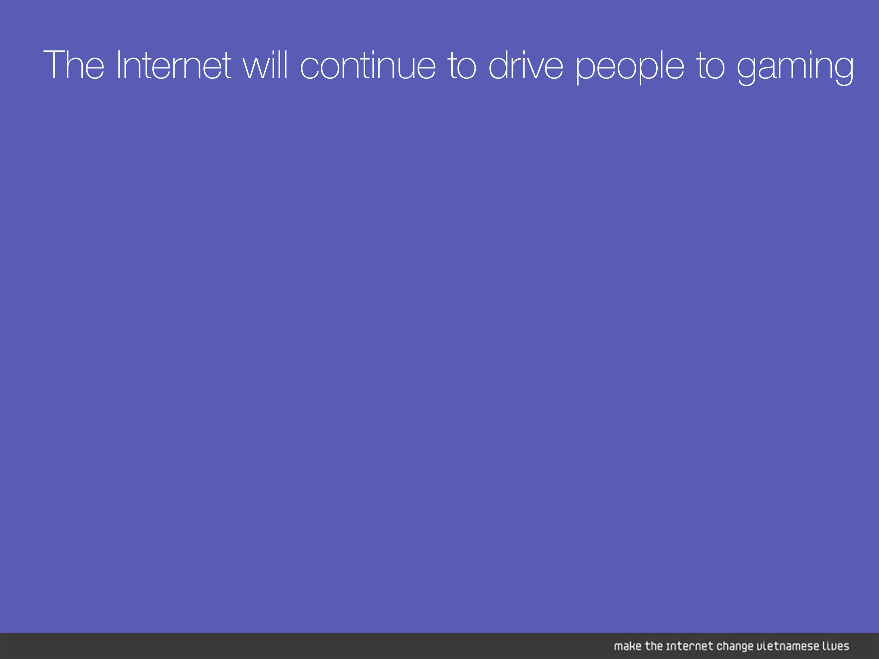
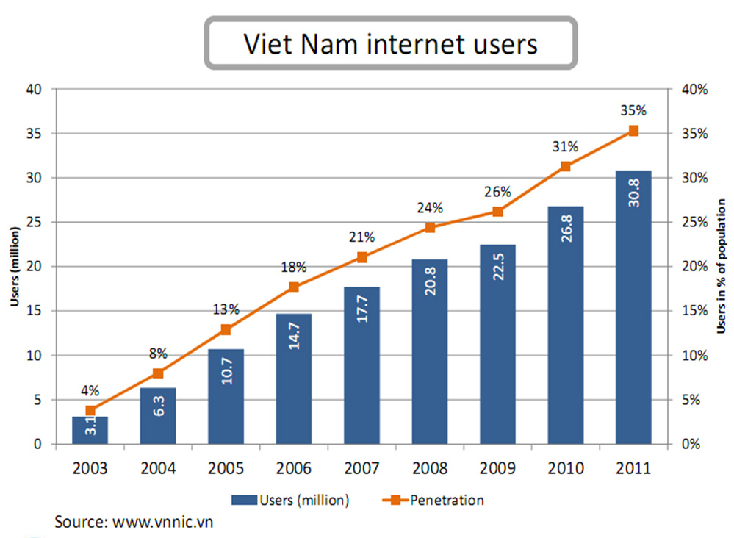

Slide 25
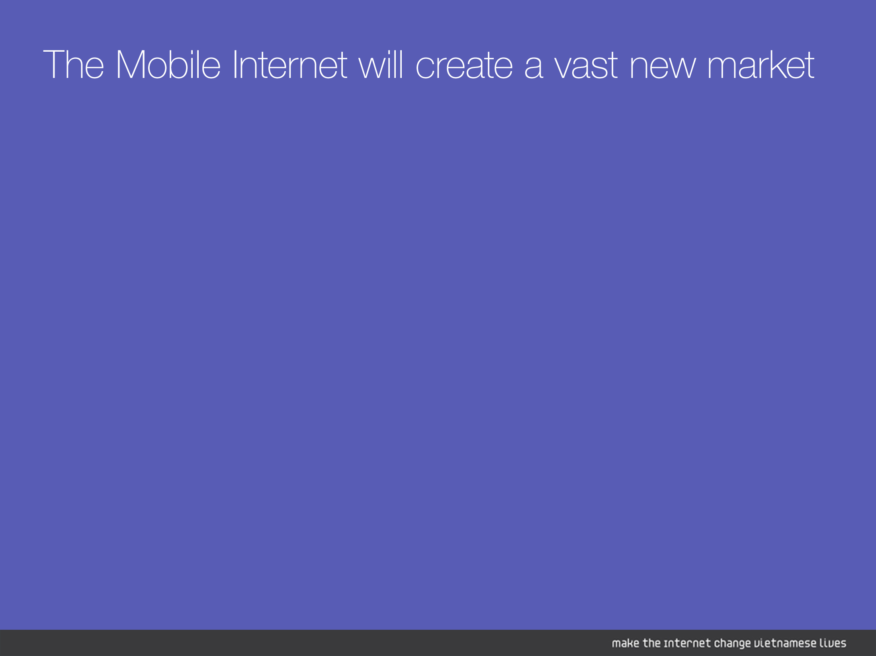
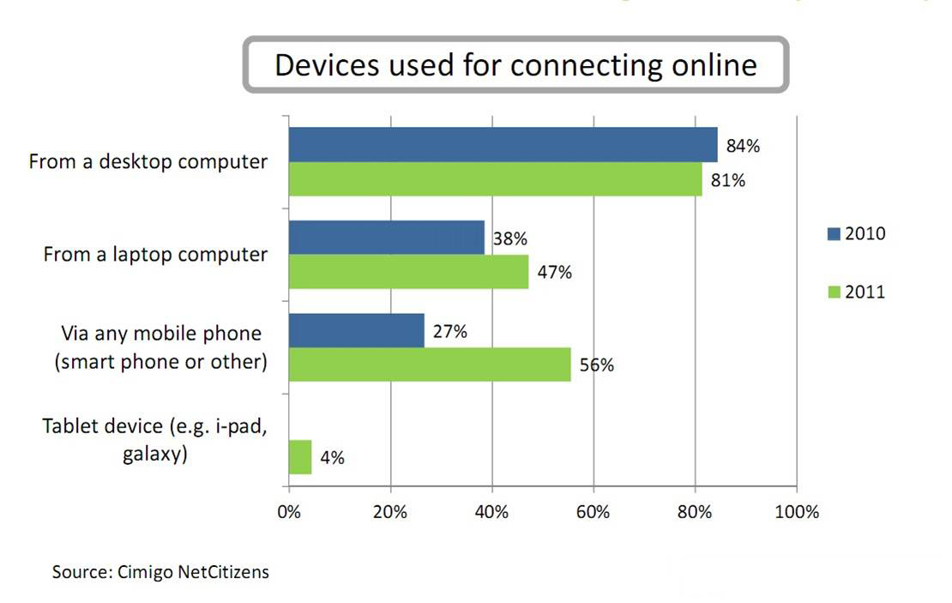

Slide 26
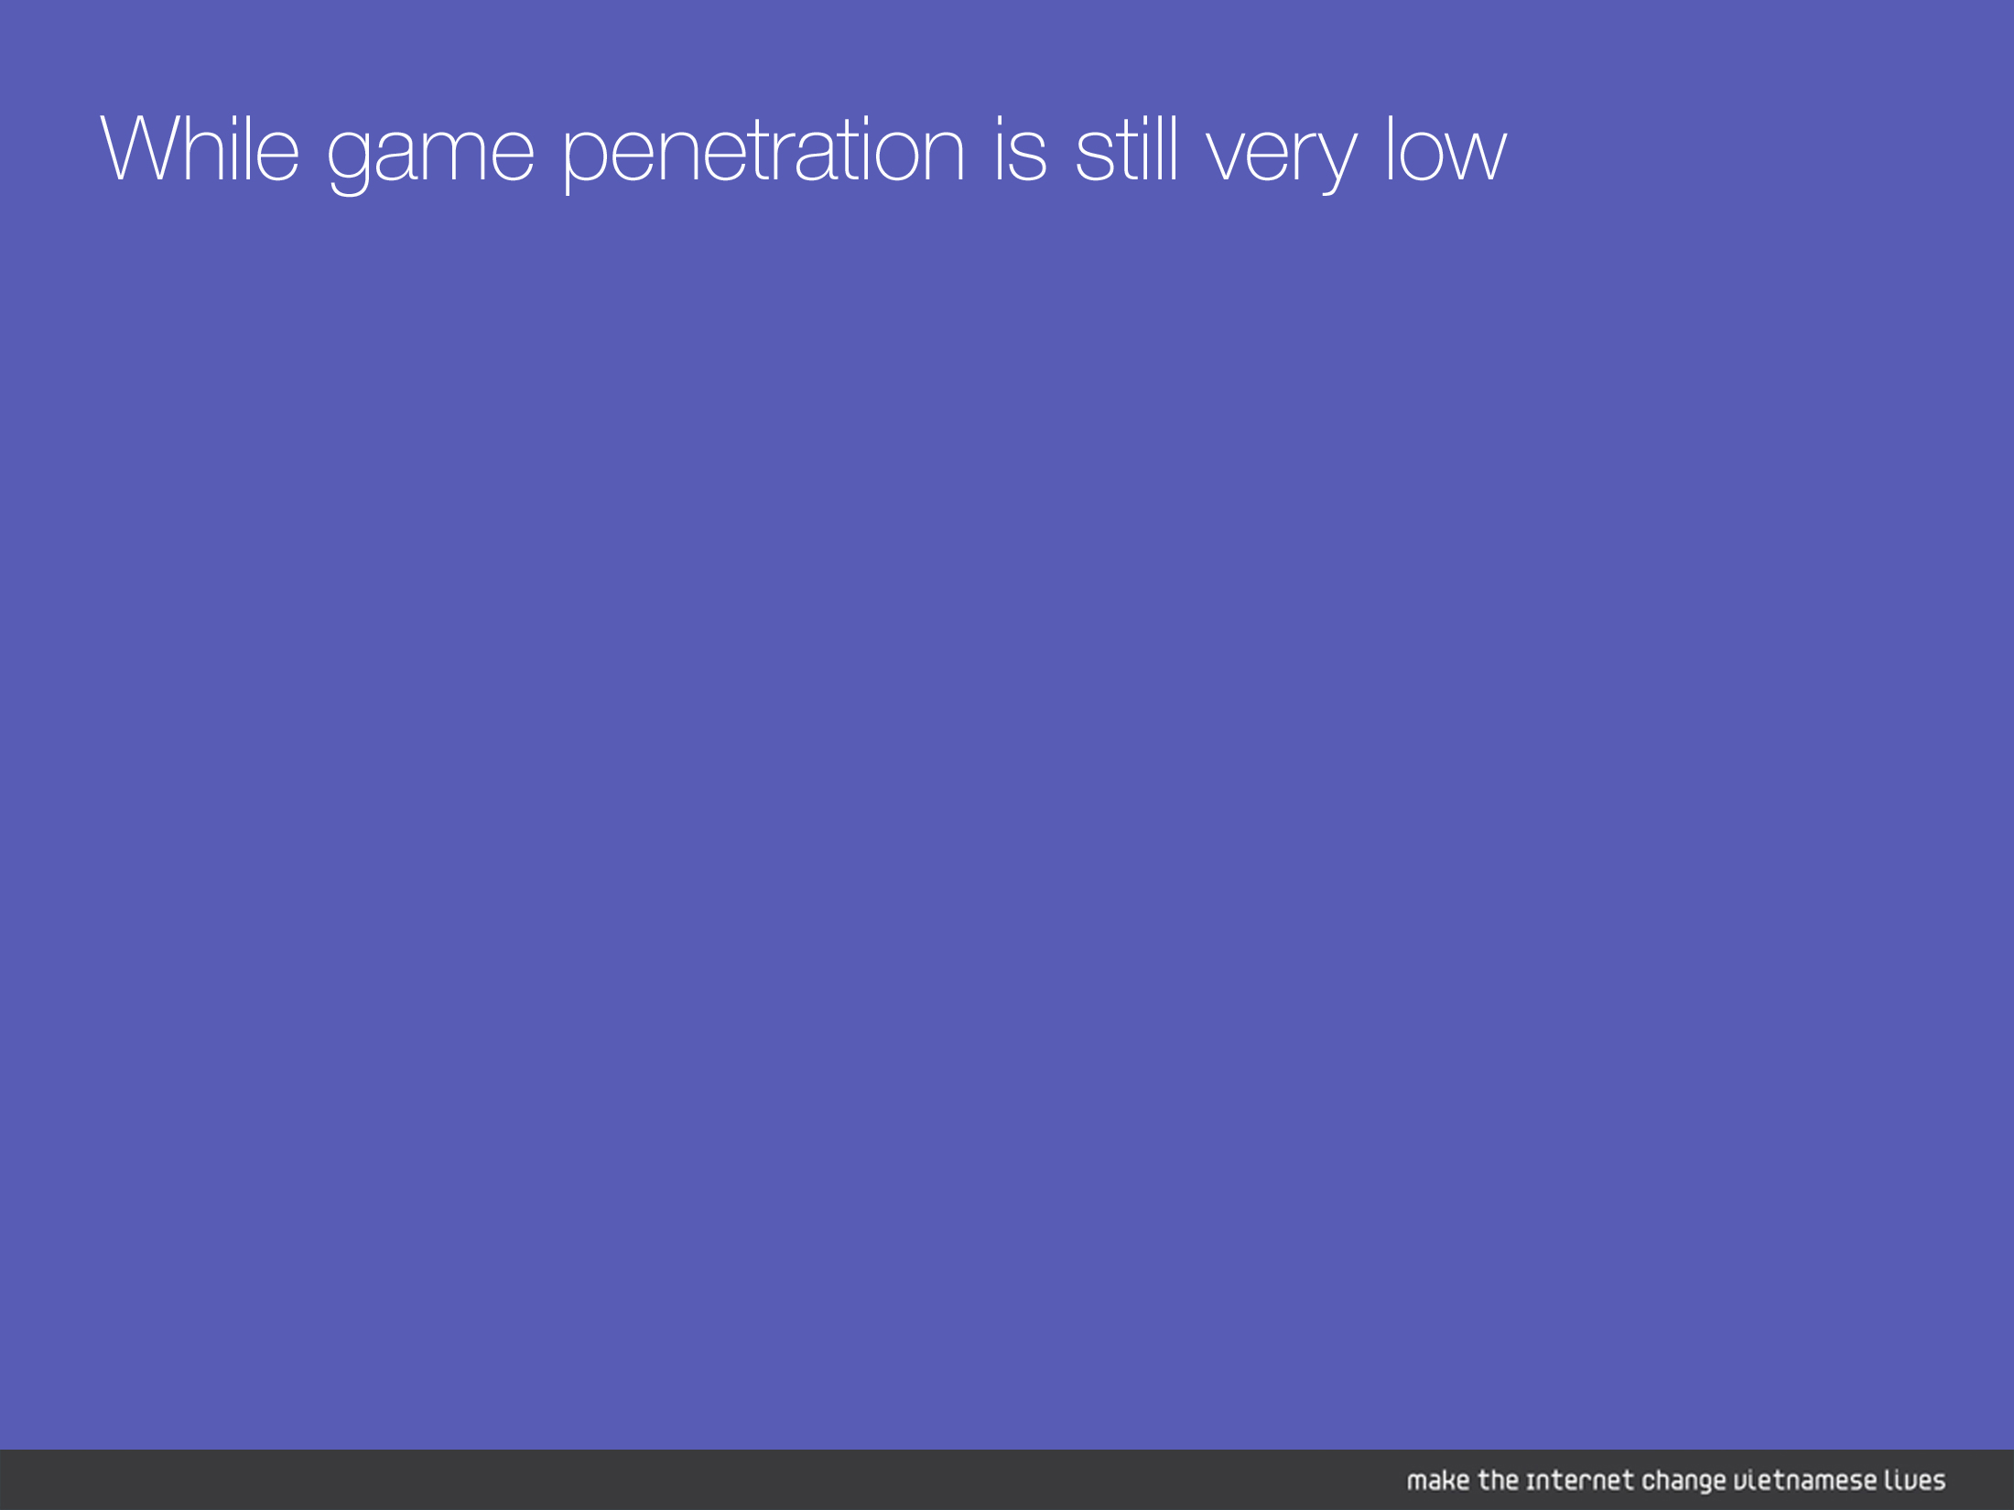
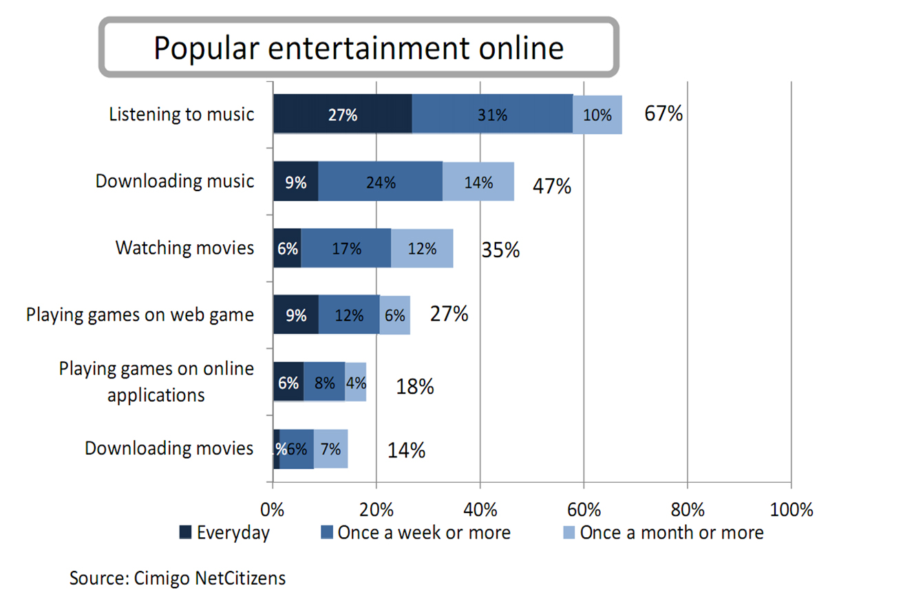

Slide 27
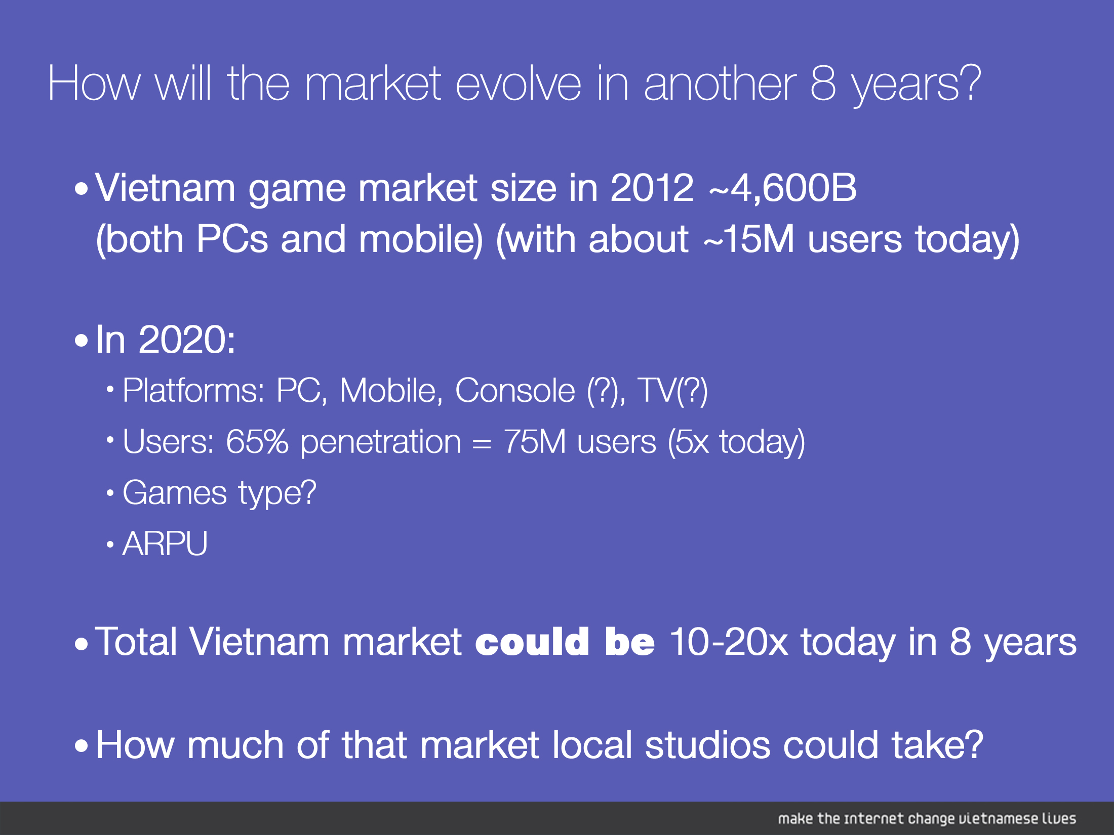

Slide 28
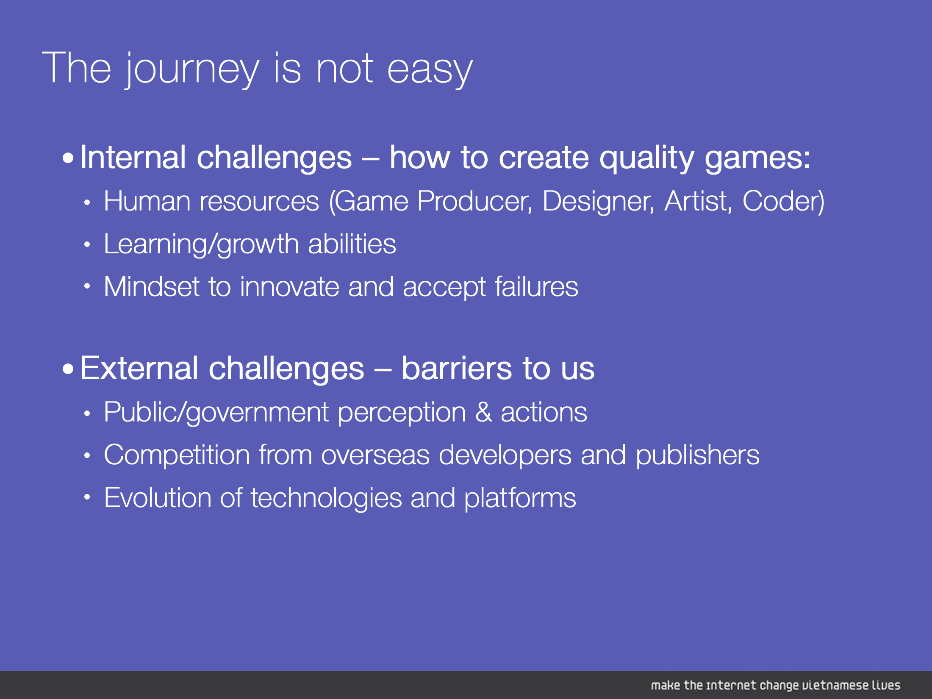

Slide 29

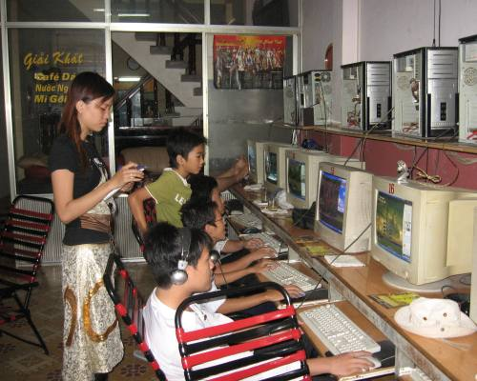

Slide 30

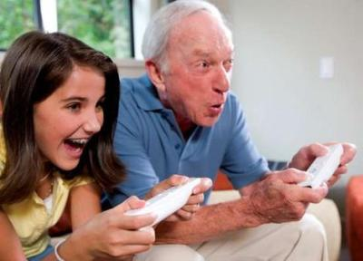

Slide 31
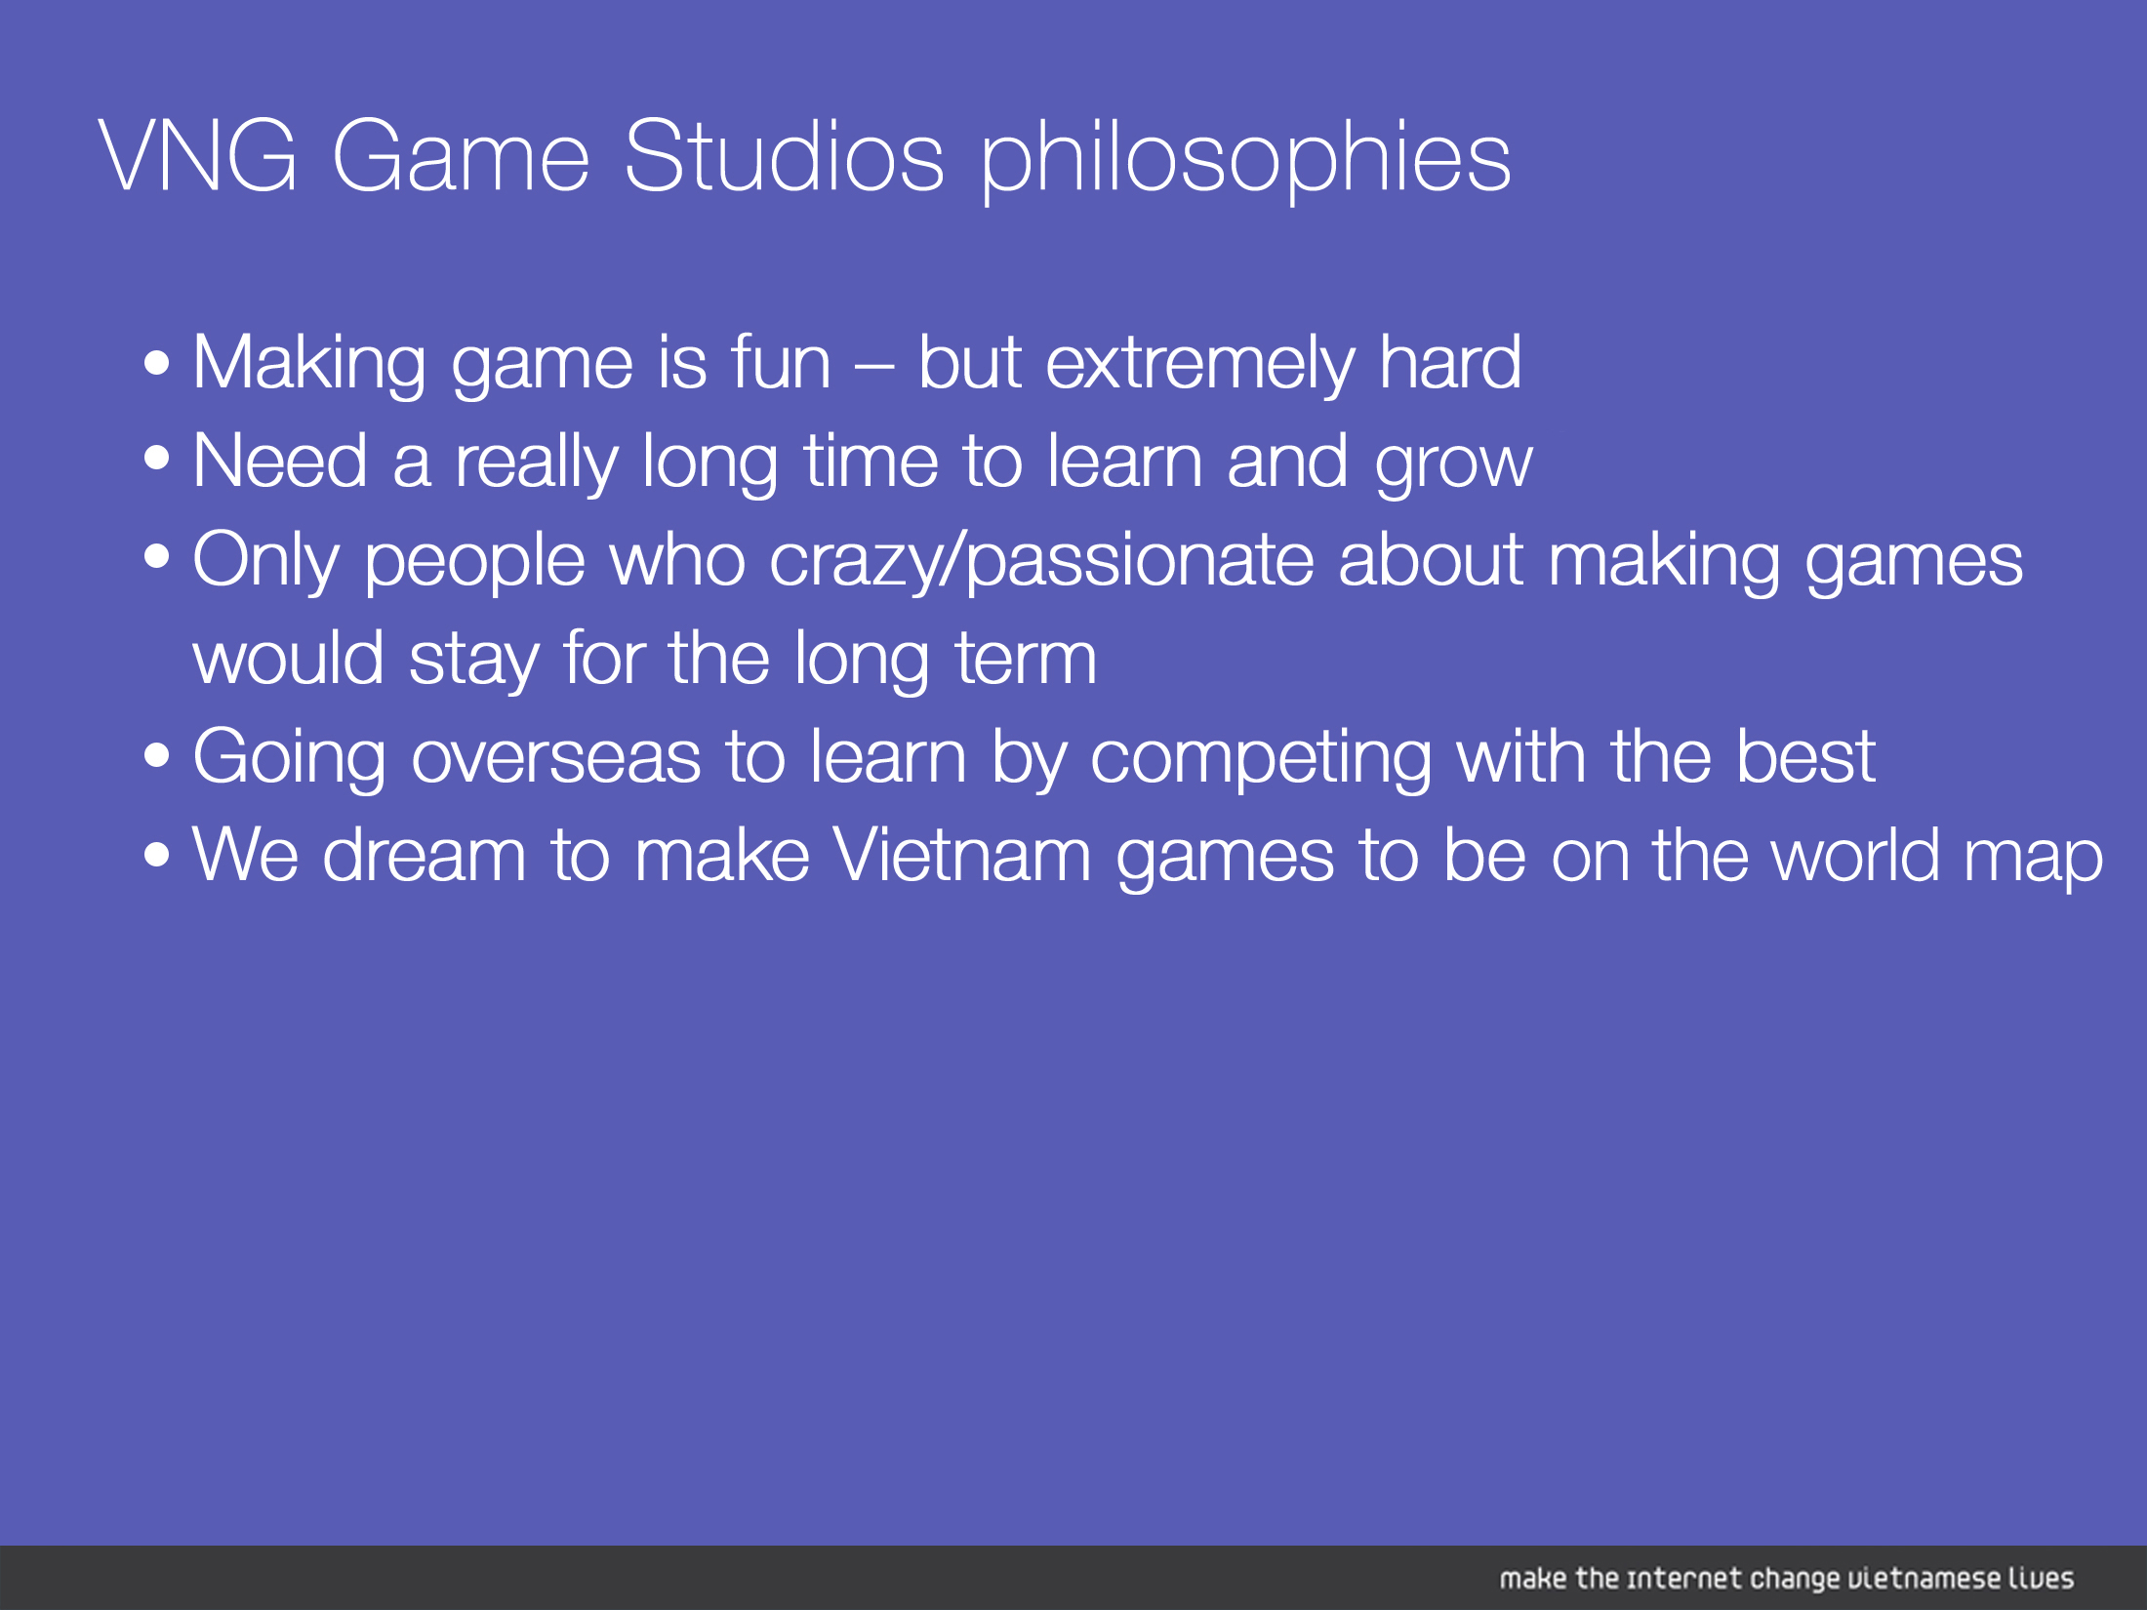

Slide 32
